Slide 1

Electric Vehicles
Are in your company’s Future
Jose Pachicano
Chief Engineer – Product Strategy
Navistar

Slide 2

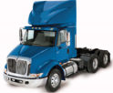

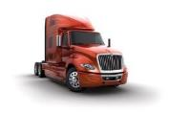

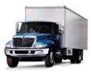





ABOUT NAVISTAR
  Major manufacturer of commercial trucks and buses
  On track for $11.5 billion in revenue in 2019
  Largest market share increase in 8 years in 2017
  Customer-centric DNA and industry-leading focus on customer uptime
  Global alliance with TRATON Group speeding technology innovation and further cost improvement
On Highway
Severe Service
Renewed and expanded entire vehicle portfolio in last two years
Medium
Bus
2

Slide 3
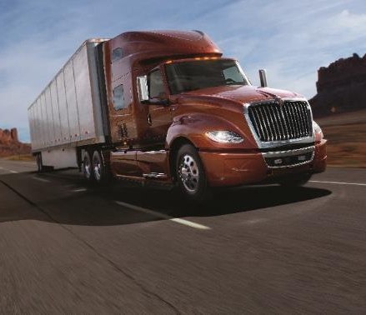
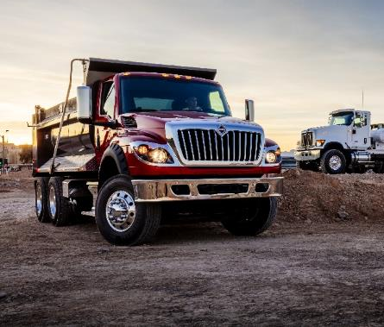
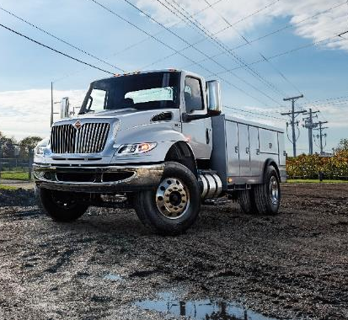

STRONG SEGMENT POSITION
14%
12%
MARKET SHARE
MARKET SHARE
HEAVY
MARKET
SIZE: 146,000
SEVERE
MARKET
SIZE: 61,000
27%
34%
MARKET SHARE
MARKET SHARE
MARKET
SIZE: 86,000
BUS
MARKET
SIZE: 35,000
MEDIUM
Source: POLK Registrations for FY2018 through February

Slide 4

BUSINESS AND PRODUCT STRATEGY AT NAVISTAR
THE STUDY OF CUSTOMER BUSINESS NEEDS AND ENABLING TECHNOLOGIES
    Understanding the needs of current and prospective customers
    Changing dynamics
    When is the time right for change
    Uncovering disruptions that can lead to a paradigm shift
Notes:
So, what exactly is the role of Navistar’s Chief Business Anthropologist?
Business Anthropology is the study of human behavior and culture. But more broadly, it is the study of change, which includes:
Understanding when the time is ripe for change.
Knowing when we’re at the cusp of a Paradigm Shift.
And, uncovering disruptions that can lead to unexpected leaps forward … for the betterment of customers, society and business.
Business Anthropologists ask one fundamental question: How deep is your understanding of the needs and behaviors of your current or prospective customers?
Traditional market analysis is all too often inadequate. It relies on “consumers as experts” and simply reports on what “consumers know they know.”
This is a risky approach, given the disruptive technologies we experience today and see on the horizon.
PhDs who study business cultural anthropology point to three facets that need to be understood and studied for a successful product launch … or for new technology to take hold in the marketplace.
These are:
Human-centric insights,
Understanding business needs and realities, and
Determining the socio-cultural factors at play.
To accomplish this, a business must do a deep dive into societal trends … gain an understanding of unmet human needs … and monitor the changing dynamics of the industry.

Slide 5



KEY FACTORS THAT DRIVE
INNOVATION / DISRUPTIVE CHANGE
    3 key factors:
    Technological
          Delivers improvements
          Technically workable
    Economic value
          Creates wealth
          Feasible for business to adopt
    Societal benefit
          Fulfills key societal need or mission
          Acceptable to regulators
TECHNOLOGY
ECONOMICS
SOCIETY
Notes:
Using the framework of Business Anthropology, I believe that the “disruptive technologies” we will discuss at this conference will be adopted as a result of how they address three key dimensions:
The technology must work …
It must deliver economic value …
And society must accept it … including the regulators who oversee societal interests.

Slide 6




KEYS TO ADOPTION OF
ELECTRIC
PROPULSION
    Enabling technology:
          Battery
    Economic value:
          Reduced total cost of ownership
    Societal benefit:
          Zero tailpipe emissions
Battery
Reduced
Total Cost of Ownership
Zero Emissions
Notes:
Electric Propulsion
And now electric vehicles – starting with battery power – can bring multiple dimensions of benefit.
For customers, they can deliver the economic benefit of lower Total Cost of Ownership.
And for society, they deliver on the goal of zero emissions.

Slide 7
ECONOMIC FACTORS DRIVING ELECTRIC:
REDUCED COST
Electric
A TIPPING POINT IS
RAPIDLY APPROACHING
Cost
Diesel
    Reduced battery cost
    Fewer parts
    Reduced maintenance costs
Time
Source: Navistar Analysis
Notes:
As to total cost of ownership for electric, a tipping point is rapidly approaching. The cost of the battery – the most expensive aspect of the vehicle – is coming down rapidly.
Once it comes down enough, the economic advantages of electric will be very clear, at least for certain applications.
Electric vehicles have many fewer moving parts, and hence require much less maintenance than internal combustion vehicles.

Slide 8
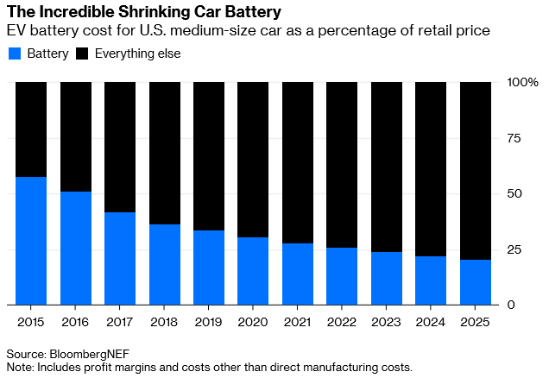
ECONOMIC FACTORS DRIVING ELECTRIC:
REDUCED COST
The REALITY of battery cost
    Rapid cost reduction
    Ample supply
    Pack technology
Notes:
As to total cost of ownership for electric, a tipping point is rapidly approaching. The cost of the battery – the most expensive aspect of the vehicle – is coming down rapidly.
Once it comes down enough, the economic advantages of electric will be very clear, at least for certain applications.
Electric vehicles have many fewer moving parts, and hence require much less maintenance than internal combustion vehicles.

Slide 9








Major OEM’s and New Entries have made Commercial EV Announcements
Volvo delivers its first electric trucks
Daimler Trucks North America to Build Electric Cascadia, M2 Trucks
Peterbilt Unveils Electric Medium-Duty Truck
Tesla Semi electric truck production back into focus
Penske Tests Fuso eCanter Electric Truck In California
BYD Continues Expansion in California
Toyota Earns Technology Award For Electric Truck At MIT Tech Symposium
Nikola unveils five new zero-emissions vehicles

Slide 10

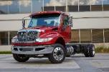


Market for Electric Commercial Vehicles
Electric Vehicle Adoption is already happening with US Transit Buses, but the larger market for electrification is with other Commercial Vehicles
250K
200K
150K
100K
50K
0

Slide 11
0.18
0.16
0.14
Daily Route Driven for medium duty truck
0.12
0.10
Frequency
0.08
0.06
0.04
0.02
0.00
50
100
150
200
250
300
350
400
Miles

Slide 12
0.06
0.05
Daily Route Driven for
heavy duty truck
0.04
Frequency
0.03
0.02
0.01
0.00
100
200
300
400
500
600
700
800
Miles

Slide 13
Product Life Cycle - Three Phases of Product Roll-out requiring different strategies
Phase 1 – Before TCO Parity
Phase 2 – At TCO Parity
Phase 3 – At Initial Purchase
Price Parity and TCO Parity
Incentives Required Battery Leasing is an Advantage Compete with Existing Technologies
Introduce in Areas with Incentives Expand Distribution Introduce in All Areas

Slide 14
HVIP Funding Available for Zero Emission Vehicles
Hybrid and Zero-Emission Truck and Bus Voucher Incentive Project (HVIP) Has funding available for Zero Emission vehicles purchased in California. As of February 2019, $90.6 Million available. First Come, first served.
$30,000 per vehicle available for charging

Slide 15

Market for Electric Commercial Vehicles
Electric Vehicle Adoption is already happening with US Transit Buses, but the larger market for electrification is with other Commercial Vehicles
250K
200K
150K
100K
50K
0

Slide 16

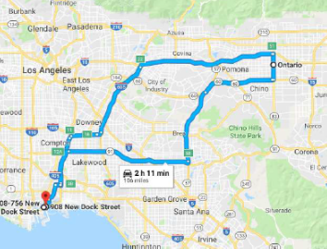

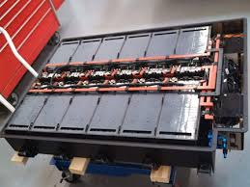
Consulting
Route Simulation
Grant Opportunities
Battery
Options

Slide 17
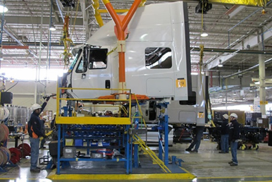
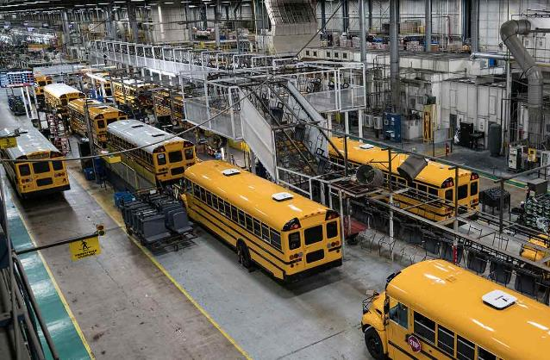
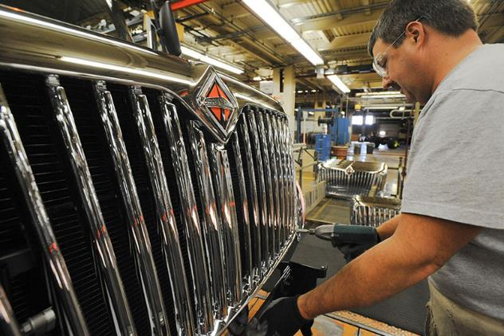
Constructing
Building Trucks & Buses
at Navistar facilities

Slide 18
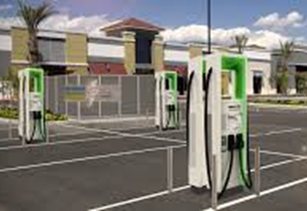
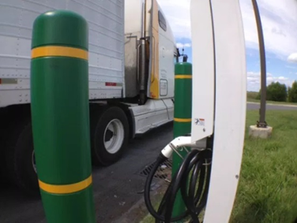
Charging
Recommend and Assist in determining Charging Hardware & Infrastructure

Slide 19
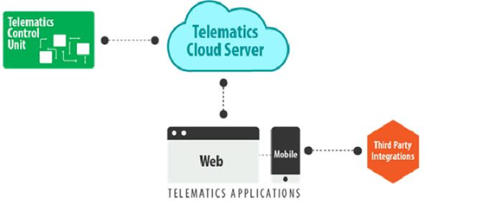

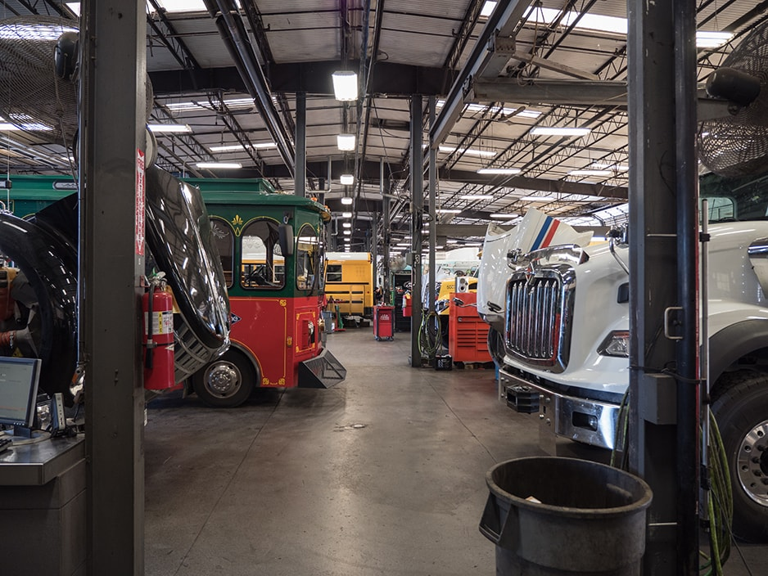
Connecting
Connect to vehicles with Telematics to monitor vehicle and battery during operation

Slide 20

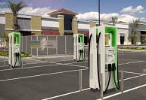





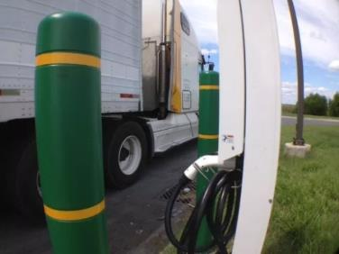
Navistar’s Approach to Electrification Implementation 4C’s
Work with Customer Through Entire EV Procurement and Implementation
CONSULTING
CONSTRUCTING
CHARGING
CONNECTING
Route Simulation to determine EV requirements and efficiencies
Share EV Funding Opportunities
Configuring and Building Trucks and Buses in Navistar Facilities
Provide Requirements of charger, infrastructure and assist in charger installation
Monitor and communicate EV vehicle performance with telematics and assist through dealer network

