Slide 1
Protecting your Workplace & Workforce During COVID-19
Tom Grumbles CIH, FAIHA

Slide 2
Purpose
Inform RIPA members about ways to operate safely in the age of COVID-19
Provide information on AIHA resources

Slide 3
Introduction to the AIHA Effort
Information on COVID-19 and return to work guidance needed by many employment sectors
CDC is often looked to but lacks the specific information employers need
AIHA RTW Guides created to help fill the gap
  22 volunteers completed 15 guides in the last 5 weeks!

Slide 4
AIHA RTW Guides
Developed for those smaller business that don't have readily available occupational health and safety resources.
Encourage employers, employees, and customers to carefully read and implement as many of the recommendations contained in the guidance document provided for your industry as possible.
Designed for “Return to Work” activity but can be used as a checklist to evaluate controls for essential businesses that never stopped work

Slide 5


AIHA Guides
This site features expert, industry-specific guidance for both businesses and consumers to safely re-open and re-engage as they emerge from the COVID-19 quarantines.
https://www.backtoworksafely.org
Notes:
Resources and links provided in slides at the end. Feedback is welcome!

Slide 6
Guides Include:
OSHA compliance in the workplace only part of the need to deal with COVID safety and health
Examples of specific topics in the Guides:
    Employee communication
    Employee wellness and screening
    Enhanced Cleaning practices
    Ventilation
    Restrooms
    Lunch rooms
    Receiving and delivery
    PPE

Slide 7
Controlling the Spread
In alignment with CDC recommendations provide employees with face coverings.
  NOTE: Face coverings primarily protect others, not yourself.
  NOTE: If an employer chooses to provide an N95 respirator, please fully consider potential OSHA Respiratory Protection Standard requirements.
Complete a task-based review/mapping of the business work areas to determine best strategies for social distancing, and ensure staff have face coverings as necessary.
Where individual workstations prevent 6 foot separation, utilize plastic/plexiglass partitions between employees if possible
Stagger breaks to reduce people in break areas and modify break areas to allow for physical distancing (i.e. limit number of chairs around table)

Slide 8
Controlling the Spread
Establish an isolated area for all delivery companies to drop off materials and supplies.
Require delivery and shipping personnel to wear mask and gloves when arriving at the site.
Consider wiping down/disinfecting all items to be sent to customers prior to shipment.
Do not share tools if possible. When tools are shared, ensure they are cleaned and disinfected before and after each use.

Slide 9
Employee Wellness
Ask employees’ to self monitor their own wellness. If they are not feeling well, they should stay home. Encourage this.
Consider screening employee temperatures onsite. Any employee who has a temperature that exceeds 100.4 degrees Fahrenheit should be further evaluated for COVID-19 symptoms to determine their ability to access the workplace.
Have a plan for steps to take if an employee tests positive for COVID (communication to staff, contact tracing, cleaning, etc.)
  Remove employees who test positive for a minimum of 14 days

Slide 10
Facility Operations
If fans, such as pedestal fans or hard mounted fans, are used in the facility, take steps to minimize air from fans blowing from one person directly at another individual.
Ensure restroom facilities are under negative pressure.
Provide paper towels in restrooms and disconnect or tape-off hand air dryers.
Increase cleaning frequency on high touch surfaces (door knobs, etc.)

Slide 11
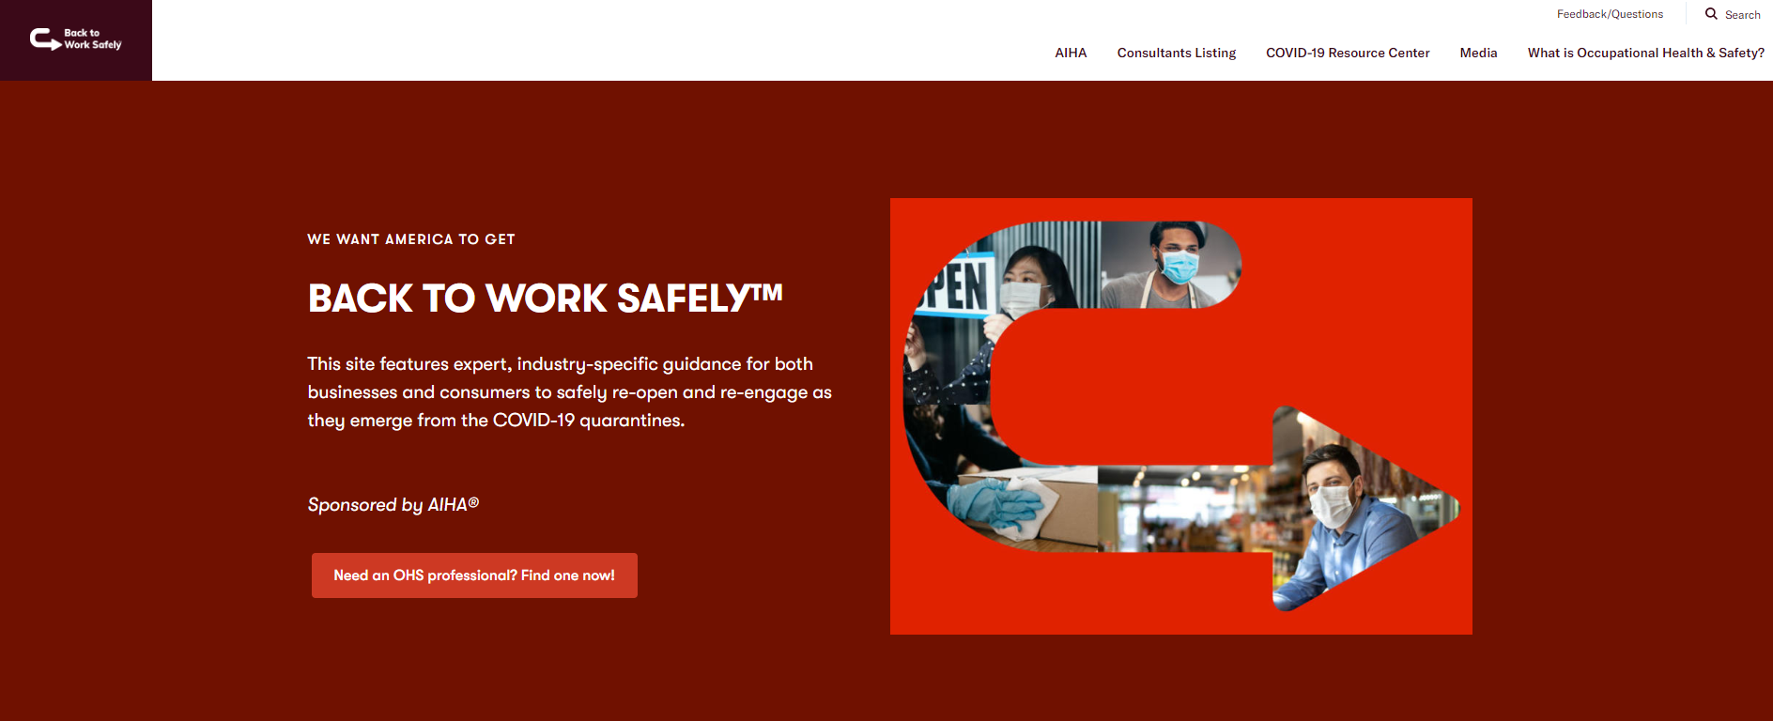
https://www.backtoworksafely.org/
Notes:
On May 1 AIHA announced the “Back to Work Safely” initiative to help employers and employees get back to work safely with industry sector specific guidelines and resources. The initiative to prepare for building re-entry after COVID-19 was launched in conjunction with Mark Cuban, entrepreneur, investor and owner of the National Basketball Association's Dallas Mavericks. This initiative is the most recent addition to a public relations campaign to clarify misinformation on PPE ventilation and disinfection and to educate employers and consumers about the hazards associated with re-entry into the workplace.
AIHA extends our sincerest gratitude to the dedicated members of AIHA’s COVID-19 Re-Open America Guidelines Task Force who worked tirelessly to develop these documents in record-time with the goal of helping people stay healthy when re-opening after the COVID-19 pandemic.

Slide 12
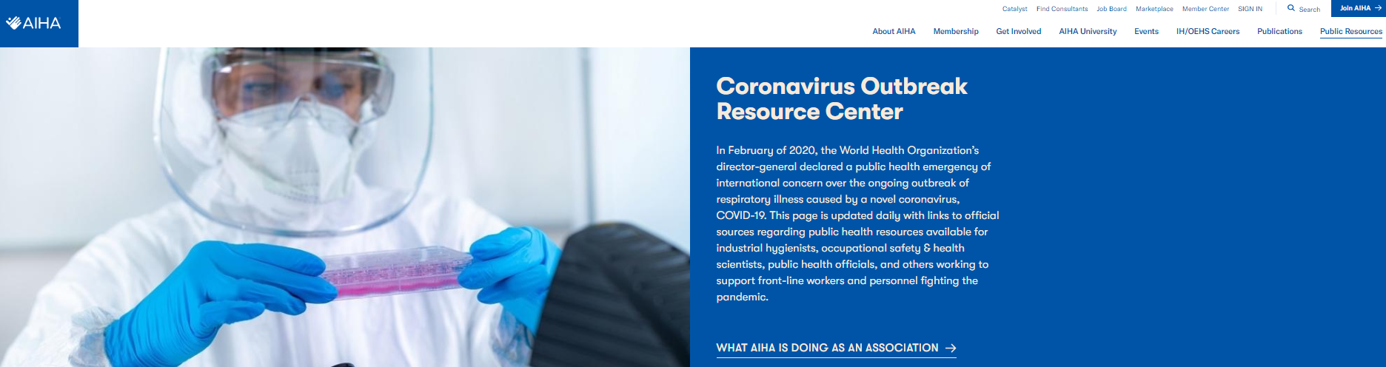
https://www.aiha.org/public-resources/consumer-resources/coronavirus_outbreak_resources/aiha-covid-19-pandemic-efforts
Notes:
Because we are getting coverage on practically a daily basis, we embedded our newsfeed scroll on AIHA’s Pandemic Efforts webpage towards the top: https://www.aiha.org/public-resources/consumer-resources/coronavirus_outbreak_resources/aiha-covid-19-pandemic-efforts for you to check on periodically.

Slide 13
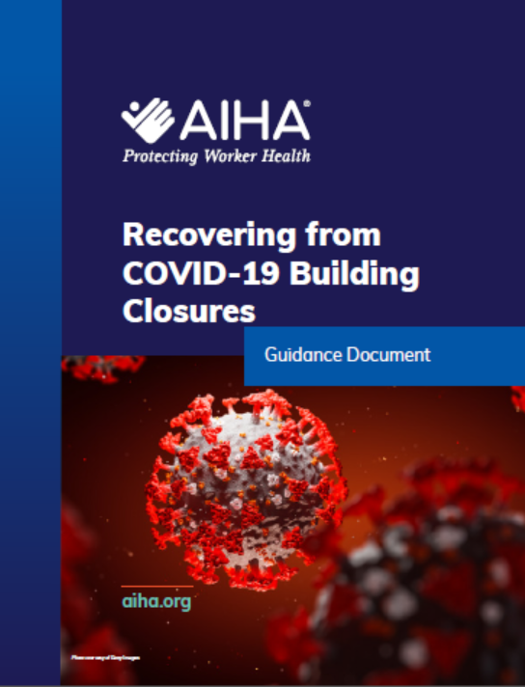
Building Owners and Operators
Maintaining Indoor Environment Conditions
HVAC
Water Systems and Legionella
Cleaning and Disinfecting
Developed by members of the AIHA Indoor Environmental Quality Committee
• David Krause, PhD, MSPH, CIH
• Cheri Marcham, PhD, CIH, CSP, CHMM, FAIHA
• John Springston, CIH, CSP, FAIHA
• Alex LeBeau, PhD, MPH, CIH
• Robert Rottersman, MS, CIH
• Timothy Froehlig, CIH
• Bart Ashley, CIH, CSP
Notes:
Building owners and operators must consider prevention now, before fully closing buildings and throughout the closure period.
Maintaining indoor environment conditions is of primary importance – specifically , controlling relative humidity. specifically, controlling
relative humidity. Building heating, ventilation, and air-conditioning (HVAC) systems are designed to operate under a heat load produced by people, computers,
lights, and other activities. People working from home and People working from home and other altered occupancy patterns reduce a building’s heat load, which can affect an HVAC system’s ability to control relative humidity levels, creating conditions for possible mold and moisture damage to occur. Operating building HVAC and mechanical systems to minimize and control relative humidity during partial and complete closures is critical in order to avoid the growth of mold in occupied spaces and HVAC systems. Neglecting to consider the impact of low to no occupancy as we enter the spring and summer months could delay reopening because of mold growth and the need to remediate.
Building water systems are critical and necessary to all building operations. Waterborne pathogens, particularly Legionella bacteria, have become a real threat to the general population, as reflected by a 650 percent increase over the past 15 years. Coincidentally, symptoms of Legionnaires’ disease are similar to those of COVID-19, both typified by fever, cough, and shortness of breath. Building-wide and neighborhood disruptions in water service have caused many outbreaks of Legionnaires’ disease in the past.
Finally, prior to re-occupancy, and periodically thereafter, it may be necessary to clean and disinfect interior occupied spaces, furnishings, and mechanical
systems, to reduce the risk of contracting COVID-19 (see current CDC guidelines).

Slide 14
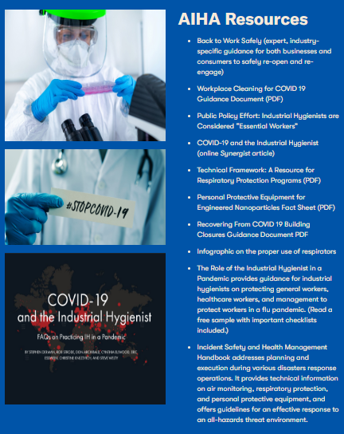

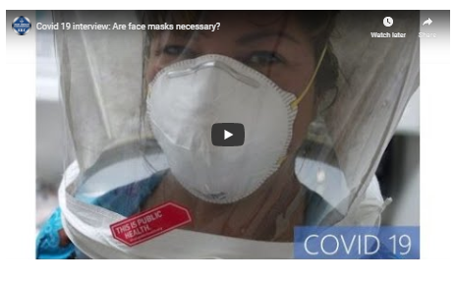
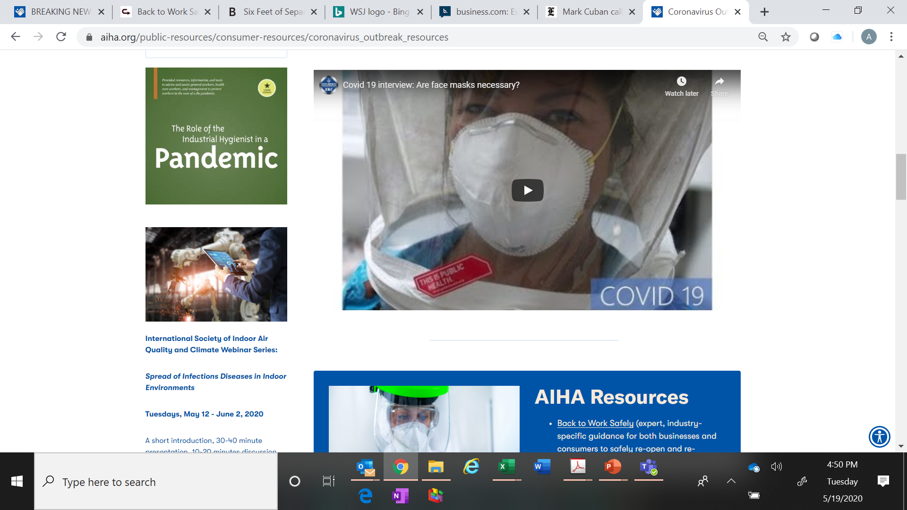
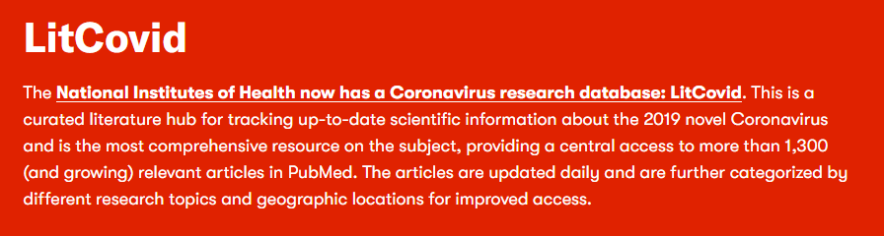
Notes:
https://www.aiha.org/media-alerts/member-letter-aiha-acoem-joint-letter-on-donation-of-surplus-masks-and-respirators-for-healthcare-workers-covid-19-march-2020

