Slide 1
Reusable Industrial Packaging Association 2025 Annual Conference Tucson, AZ
REGULATORY PLENARY SESSION

Slide 2
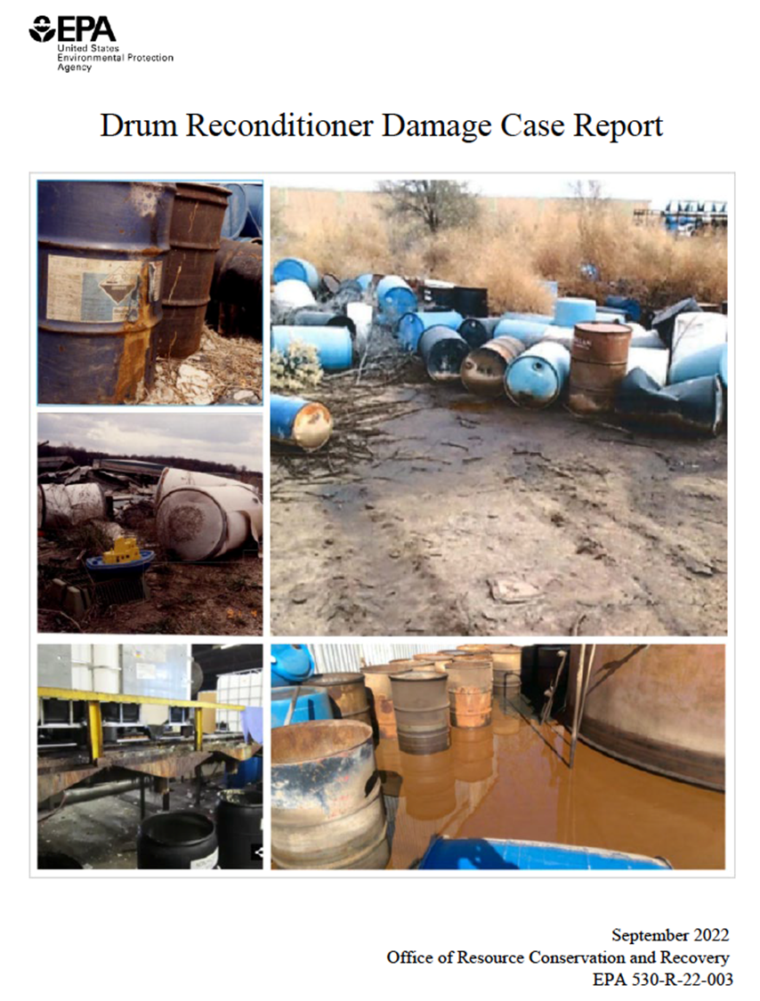
Update: EPA Empty Container Issues
Overview
September 2022, EPA issues “Drum Reconditioner Damage Case Report”
The report painted the industry in a terrible light and included numerous factual errors.
RIPA responded with a lengthy letter in early 2023, refuting much of the report.
In August 2023, EPA issued an Advance Notice of Proposed Rulemaking: RIPA responded

Slide 3
Update: EPA empty container issues
RIPA also organized a 24-member coalition of national trade groups (U.S. Chamber; NACD, NAM, ACC, ILMA, IPANA, etc.). All these groups commented and asked EPA to:
- Keep the empty container rule
- Not regulate reconditioners as TSDFs
In March, Kearny Steel Drum hosted EPA for a tour of its New Jersey steel drum and IBC plant.
Trump takes office in January 2025; initiates massive de-regulation effort.
Summer of 2025: RIPA/AFPM meet with key EPA leadership – EPA makes clear it is not interested in rulemaking and wants voluntary compliance. Emphasizes fire protection procedures at reconditioning facilities.

Slide 4
Update: EPA empty container issues
September 2025 – AFPM sends letter to Steven Cook (EPA) asking Agency to invest $2 million in national education program aimed at emptiers and reconditioners. Program would include creation of:
Compliance tools
Training materials
Awareness campaigns
It is would not clear if EPA will recommend or provide funds.
RIPA leadership believes that the association should organize a national education program in cooperation with EPA and association partners.

Slide 5
RIPA National Empty Container Compliance Program
RIPA has drafted “A National Compliance Program” focusing on the management of emptied industrial packagings.
The program contains four elements:
Understanding empty container management regulatory requirements;
Standard procedures for emptiers of industrial packages;
Standard procedures for managing non-RCRA empty packages at reconditioning facilities; and
Standard procedures for managing containers at reconditioning facilities to reduce fire risks.

Slide 6
Model Empty Residue Container Policies for Corporations (Emptiers)

Slide 7
Model Empty Residue Container Policies for Corporations (Emptiers)
This empty container management system is intended to be used by companies that receive and then empty industrial packages that contain regulated materials. It addresses both regulatory compliance and practical implementation challenges.
The term “industrial container” includes all containers 30 liters (7.9 gallons) to 3,000 (792.6 gallons) liters in size.
The Policies apply to all industrial containers used by [Company name], including containers that contain or formerly contained hazardous products as defined by the U.S. Department of Transportation or hazardous chemicals as defined by the U.S. Environmental Protection Agency.

Slide 8
Model Empty Residue Container Policies for Emptiers
Industrial containers shall be emptied to the maximum extent practicable, using emptying procedures approved by [Company name]. Industrial containers that previously contained hazardous products shall be emptied sufficiently to ensure they comply with the federal EPA empty container standard.
Industrial containers emptied in the company’s California facilities shall meet the state empty packaging standard (22 CCR 66261.7)
All industrial containers shall be closed, using appropriate closures, sufficient to ensure no leakage occurs in storage or transportation.
Marks and labels appearing on the original industrial container when it was received shall not be removed or purposely defaced by plant personnel prior to storage or transportation.

Slide 9
Model Empty Residue Container Policies for Emptiers
All empty industrial containers shall be transported to container reconditioning facilities that have been approved by [Company name].
At each company facility that empties industrial containers, a designated individual shall be responsible for ensuring that industrial containers leaving the facility are “empty” as that term is defined in the RCRA empty container standard.
The individual responsible for ensuring [Company name] compliance with this Policy shall sign or have signed an “empty container certificate” or similar document that confirms both that the industrial containers leaving the facility are empty and that the containers have been properly prepared for transportation.

Slide 10
Model Empty Residue Container Policies for Emptiers
If a container is determined to be not in compliance with the RCRA empty container standard, [Company name] will arrange for the return transportation of the container(s) to the plant for further emptying. [Company name] shall provide the motor carrier with a completed shipping paper in accordance with DOT regulations in advance of the return shipment.
Non-compliant containers sent to a reconditioning facility may also be directed to a licensed hazardous waste disposal facility, in accordance with a signed agreement with the reconditioner. This activity may only occur if the shipment meets all applicable regulatory requirements, including the use of a signed hazardous waste manifest form and a properly licensed transporter.

Slide 11
Model Empty Container Management Policies for Reconditioners

Slide 12
Model Empty Container Management Policies for Reconditioners
Shipper certification of empty container shipments
An empty container certificate should be signed by the customer and either accompany each shipment of containers or otherwise be provided to the reconditioner in coordination with the shipment. The certificate confirms that the containers are RCRA-empty and have been properly prepared for transportation.
Emptiers should ensure that each empty container can be identified by the reconditioner upon receipt at the reconditioning facility. For less-than-truckload shipments this may require the application of a mark on each container that clearly identifies the name and location of the shipper. CONTROVERSIAL

Slide 13
Model Empty Container Management Policies for Reconditioners
By contract with reconditioners, shippers should agree to take back non-empty (“non-conforming) containers in accordance with all applicable regulatory requirements.
Non-conforming containers should be
- Marked with a “rejected label” indicating the date of arrival, senders name, carrier’s name if available, and a statement the container has been rejected by the reconditioner.

Slide 14
Model Empty Container Management Policies for Reconditioners
Non-conforming containers should be placed in a designated holding area, which is regularly inspected.
Non-conforming containers will not remain at a reconditioners for longer than XXX days.
IMPORTANT – How many days? Starting from time of ID?
The reconditioner will contact the customer and document this contact.
If the customer fails to retrieve the container in XXX days, the reconditioner will send it to a RCRA waste facility. How many days?

Slide 15
Model Procedures for Managing Fire Risks at Reconditioning Facilities
Reconditioners are subject to OSHA requirements addressing fire prevention.
All flammable materials (e.g., propane, gasoline, kerosene, etc. must be stored in containers compliant with OSHA regulations.
Welding, hot work, etc. shall be conducted in compliance with OSHA requirements.
All facilities shall have a no smoking policy in all operating areas.

Slide 16
Model Procedures for Managing Fire Risks at Reconditioning Facilities
Equipment that could contribute to a fire risk shall be inspected regularly and repaired as necessary.
Routine housekeeping shall be performed at least monthly to reduce trash, dust and combustible debris, particularly near area with combustibility risks.
Paint booths are to be inspected at least weekly.

Slide 17
Model Procedures for Managing Fire Risks at Reconditioning Facilities
Tools using batteries and battery charging stations shall be inspected weekly. Charging stations shall be in dedicated areas away from flammable materials, trash and debris.
Used batteries shall be managed in accordance with applicable state and federal requirements.
IMPORTANT: Containers wither residues of DOT Hazard Class 5.1 (Oxidizers) and 5.2 (Organic Peroxide) materials should be rinsed sufficiently to remove the chemical hazard PRIOR TO acceptance at a reconditioner’s facility.

Slide 18

DOT REGULATORY UPDATE

Slide 19
DOT REGULATORY UPDATE
The U.S. DOT issued an Advance Notice of Proposed Rulemaking (HM-265B) seeking information from regulated entities on regulations or Special Permits/Approvals it should amend or repeal, as well as ideas regarding ways to make the HazMat regulations more efficient. Very pro-business.
RIPA asked DOT to do the following:
(1) Special Permits

Slide 20
DOT Regulatory Update
Add the following Special Permits issued to reconditioners in the HMR - DOT-SP 16323: Installation of previously tested new inner receptacle in an IBC
- DOT-SP 21231: Allows reconditioning of 10/8/10 open- & tight head steel drums
- DOT Approval CA 2009050053 – Authorizes us of ultrasonic testing for all containers
(b) DOT should revise the way Special Permits and Approvals are issued to ensure that holders of “party-to” status retain their authorization even if the original holder is no longer an operating entity.

Slide 21
DOT Regulatory Update
(c) DOT should notify holders of Special Permits and Approvals in advance of the expiration date; and, in another comment (HM-268G), asked that SP holders could ask for a renewal all the way to date of SP expiration. Currently, 60-days in advance.
DOT should extend the renewal period for “M” (and “R”) numbers from 5 years to 10 years.
(e) Ensure that holders of SPs & As can renew their authorization even if the original holder of the SP or A is no longer in business

Slide 22
DOT Regulatory Update
Limit the use of LOGSA (Tobyhanna) to testing packagings that “have failed in transportation or which are deemed by DOT to present a significant risk of failure in transportation.
Extend to three (3) years the interval between periodic testing requirements for UN packagings. Current requirement is annual testing.

Slide 23
Regulatory Update: DOT Inspection Checklist
Ask the DOT inspectors for their ID
Ask why inspector is at your plant
Keep copies of all DOT records in one location: Make sure at least one other persons knows where to find them
Customer information:
DOT inspectors can ask for customer information – 3 or 4 names will suffice with pricing info. redacted

Slide 24
Regulatory Update: DOT Inspection Checklist
Employees should be able to answer basic questions about their jobs.
You or another manager should accompany the inspector on the tour.
Prepare in advance for an inspection
Create your own written record of the visit and what was observed. Take pictures.
On-site testing – RIPA recommends you not test on site; send containers to Tobyhanna.

Slide 25
Regulatory Update: DOT Inspection Checklist
Keep
Keep a copy of the completed exit briefing form.
Call
Call your lawyer or RIPA if problems have been identified
Fix
Fix the problem asap.
Respond
Respond to the exit briefing within statutory limit of 30 days.

Slide 26

FMCSA: Limits on CDLs and CLPs for Non-Domiciled Drivers

Slide 27
CDL/CLP Limits for Non-Domiciled Drivers
Interim FINAL RULE restricting how states issue commercial driver’s licenses and commercial learner’s permits to individuals from outside of the United States. The rule is effective immediately.
Limits individuals eligible for non-domiciled CLPs and CDLs to foreign individuals in lawful status in the United States.
Requires non-citizen applicants (except for lawful permanent residents) to provide an unexpired foreign passport and an unexpired Form I-94/94A (Arrival/Departure Record)

Slide 28
CDL/CLP Limits on Non-Domiciled Drivers
Requires state drivers licensing agencies to be more vigilant and retain records for two years.
Requires the applicant to be present in-person at each renewal.

Slide 29
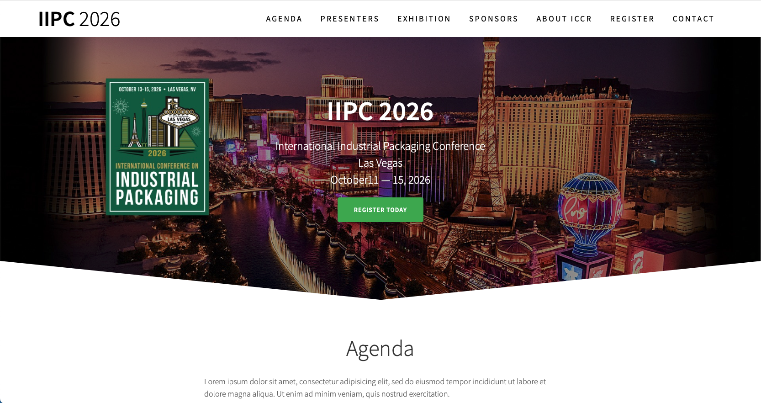

Slide 30

International Conference on Industrial Packaging
WHEN: October 13 – 15, 2026
WHERE: Cosmopolitan Hotel, Las Vegas, NV
THEME: Smart Production – Circular Solutions – Global Collaboration

