Slide 1
IPANA 2024 Annual Conference
October 17, 2024
Navigating Through Economic and Political Uncertainty:
The Opportunities and Risks Ahead
www.EconomicOutlookGroup.com
Bernard Baumohl
Chief Global Economist The Economic Outlook Group, LLC
475 Wall Street, Princeton, NJ 08540
(609) 529-1300

Slide 2
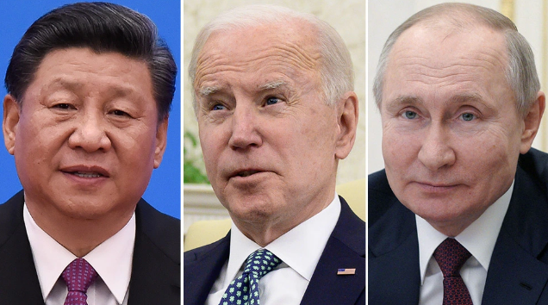
A maelstrom of forces will shape the economy 2025 – 2028
Event risks:
• Wider wars in Middle East & Ukraine
• Tensions rise over SCS, Taiwan
• Attacks on maritime shipping
• Outbreak of trade war
Presidential elections
• Who wins the White House?
• Which party controls the House
and Senate---and by what margin?
Inflation & interest rates:
• Will inflation continue to ease?
• How much more will the Fed
cut rates and when?
China and Europe:
• When will their economies
come back on line?
The Economic Outlook Group

Slide 4
Inflation should reach the Fed’s 2.0% target before the end of this year
CPI Peak
June 2022 = 9.0%
CPI inflation
% Change from 12 months ago
PCE Inflation Peak
June 2022 = 7.1%
Personal Consumption Expenditures (PCE): Chain-type Price Index
% Change from 12 months ago
CPI
Sept. 2024 = 2.4%
PCE Inflation
August 2024 = 2.2%
Federal Reserve 2.0% inflation target
Sources: Bureau of Economic Analysis, Bureau of Labor Statistics via FRED
The Economic Outlook Group

Slide 5
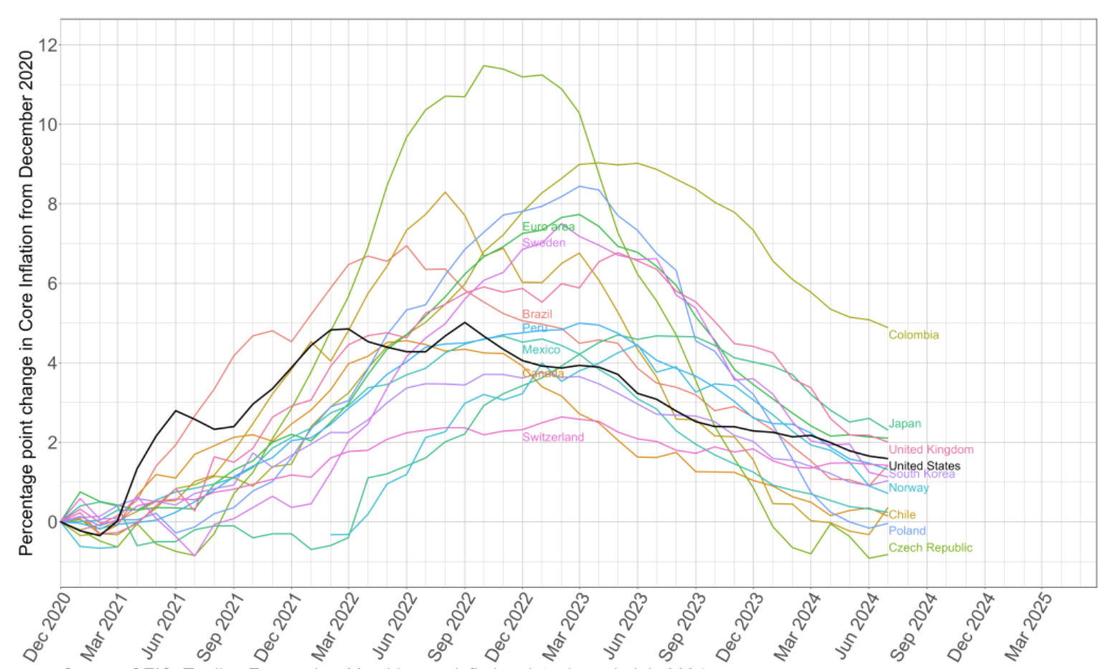
Let’s call it right:
EVERY NATION experienced a temporary surge of inflation following the Covid-19 pandemic
Sources: World Bank; IMF, National statistical agencies
The Economic Outlook Group

Slide 6
The Federal Reserve achieved something rare in history!
They boosted interest rates to cool inflation without causing a recession and much joblessness.
Unemployment rate, monthly
Unemployment rates
April 3.9%
May 4.0%
June. 4.1%
July 4.3%
Aug. 4.2%
Sept. 4.1%
(Actually Sept. 4.051%)
Source: Bureau of Labor Statistics
The Economic Outlook Group

Slide 7
Federal Reserve to lower rates another 50 bps by end of 2024, to a range of 4.25% - 4.50%
After that, the path of rates will depend on future tax, tariff and immigration policies.
Fed funds target, upper limit
Fed funds = 5.25% - 5.50%
Current = 4.75% - 5.00%
Current = 4.10%
10 yr. Treasury yield
Forecast:
25 bp cut Nov. 6-7
25 bp cut Dec. 17-18
Source: FRED
The Economic Outlook Group

Slide 8
What’s Next? Shifting US economic trends
Consumer spending alert
Commercial real estate woes
Manufacturing in historic transition

Slide 9
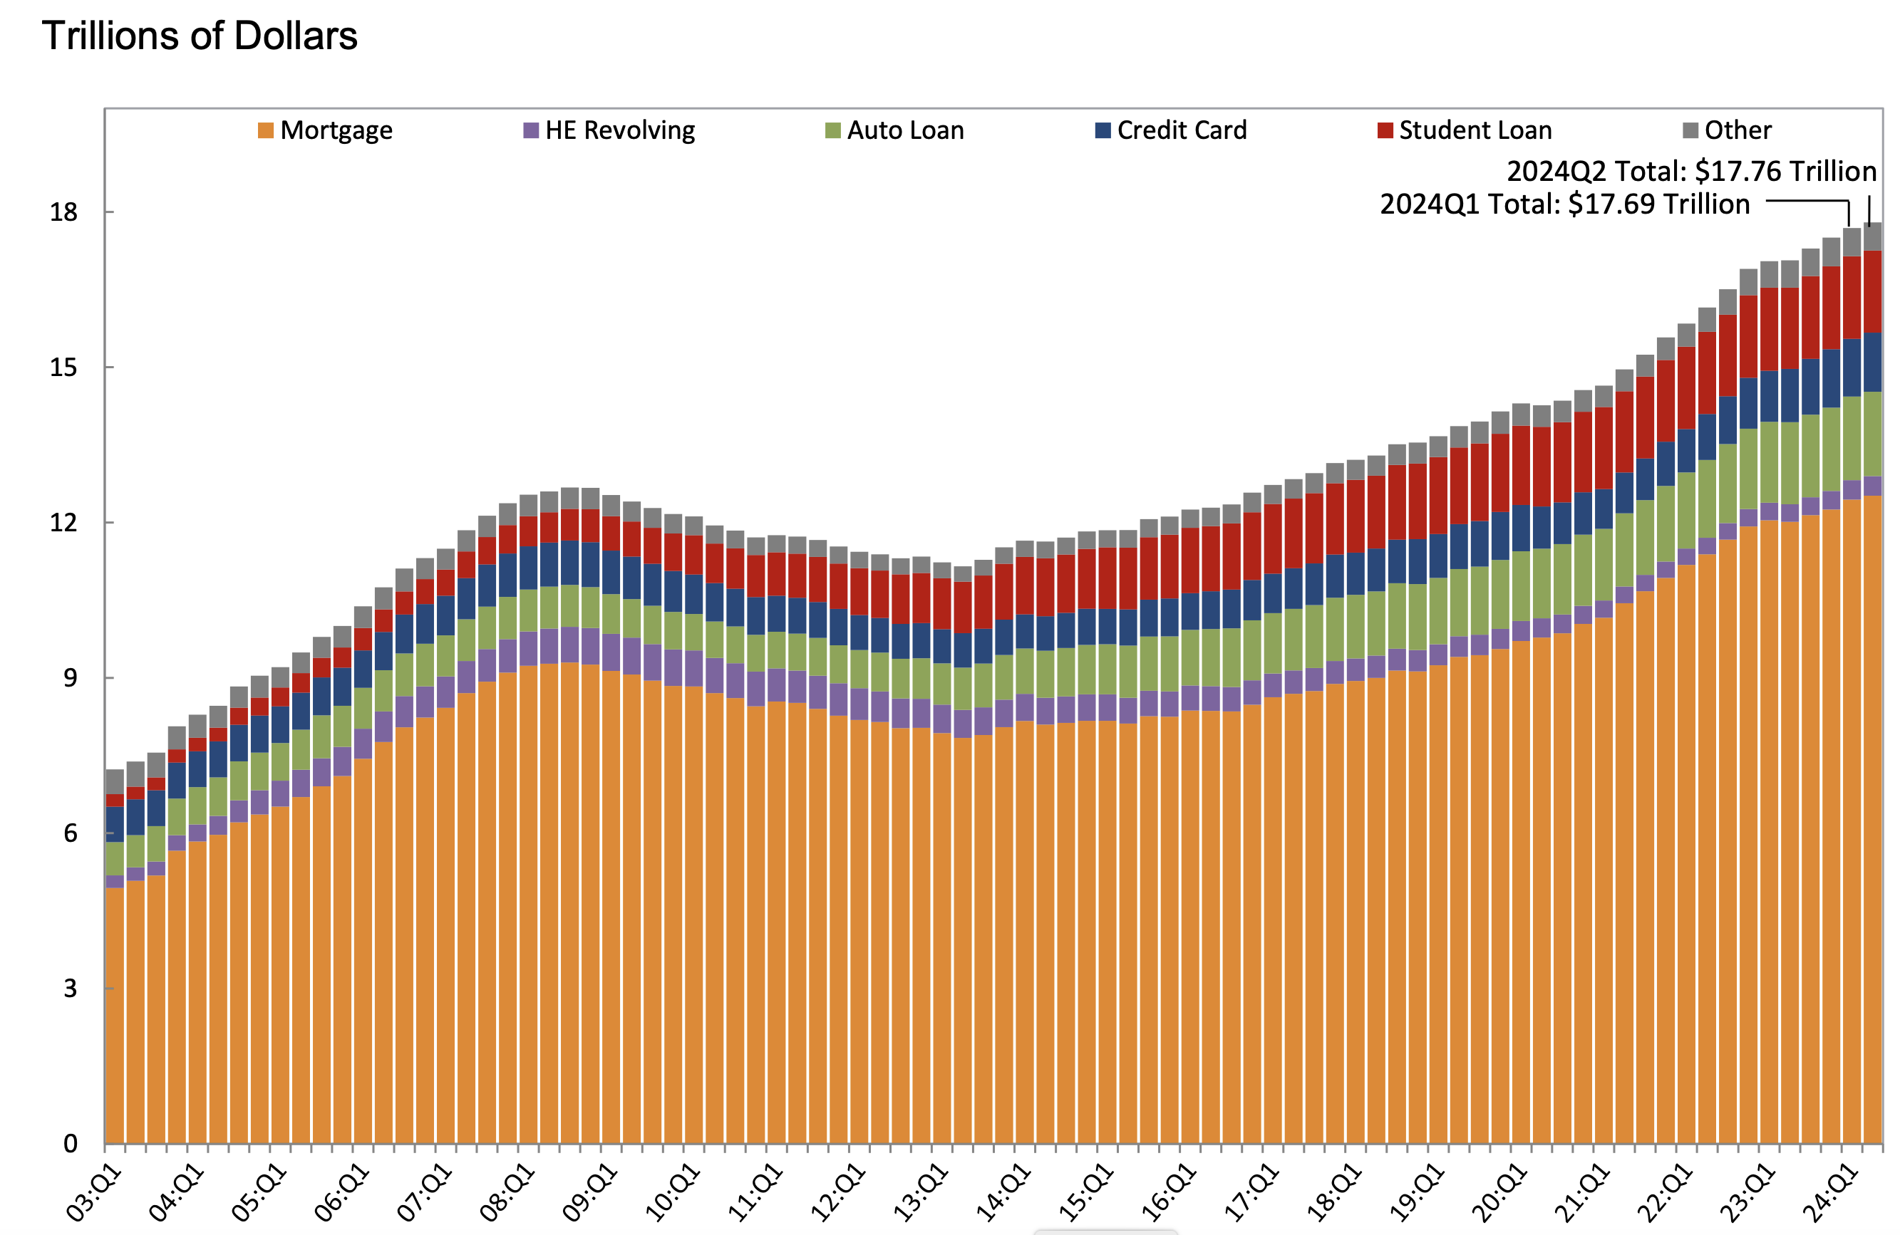
Total US Household Debt and its Composition
(9%)
(3%)
(70%)
(2%)
(9%)
(6%)
End of 2Q 2024
RECORD total US household debt = $17.76 Trillion
RECORD credit card debt held by consumers = $1.14 Trillion
Source: Federal Reserve Bank of New York
The Economic Outlook Group

Slide 10
Interest rates on Bank Credit Cards are the highest since the Fed tracked this series in 1994!
Commercial Bank Interest Rate on Credit Card Plans, All Accounts
21.51%
Long-term average bank credit card rate (14.12%)
March 2022:
Federal Reserve begins
to raise rates
Source: Federal Reserve
The Economic Outlook Group

Slide 11
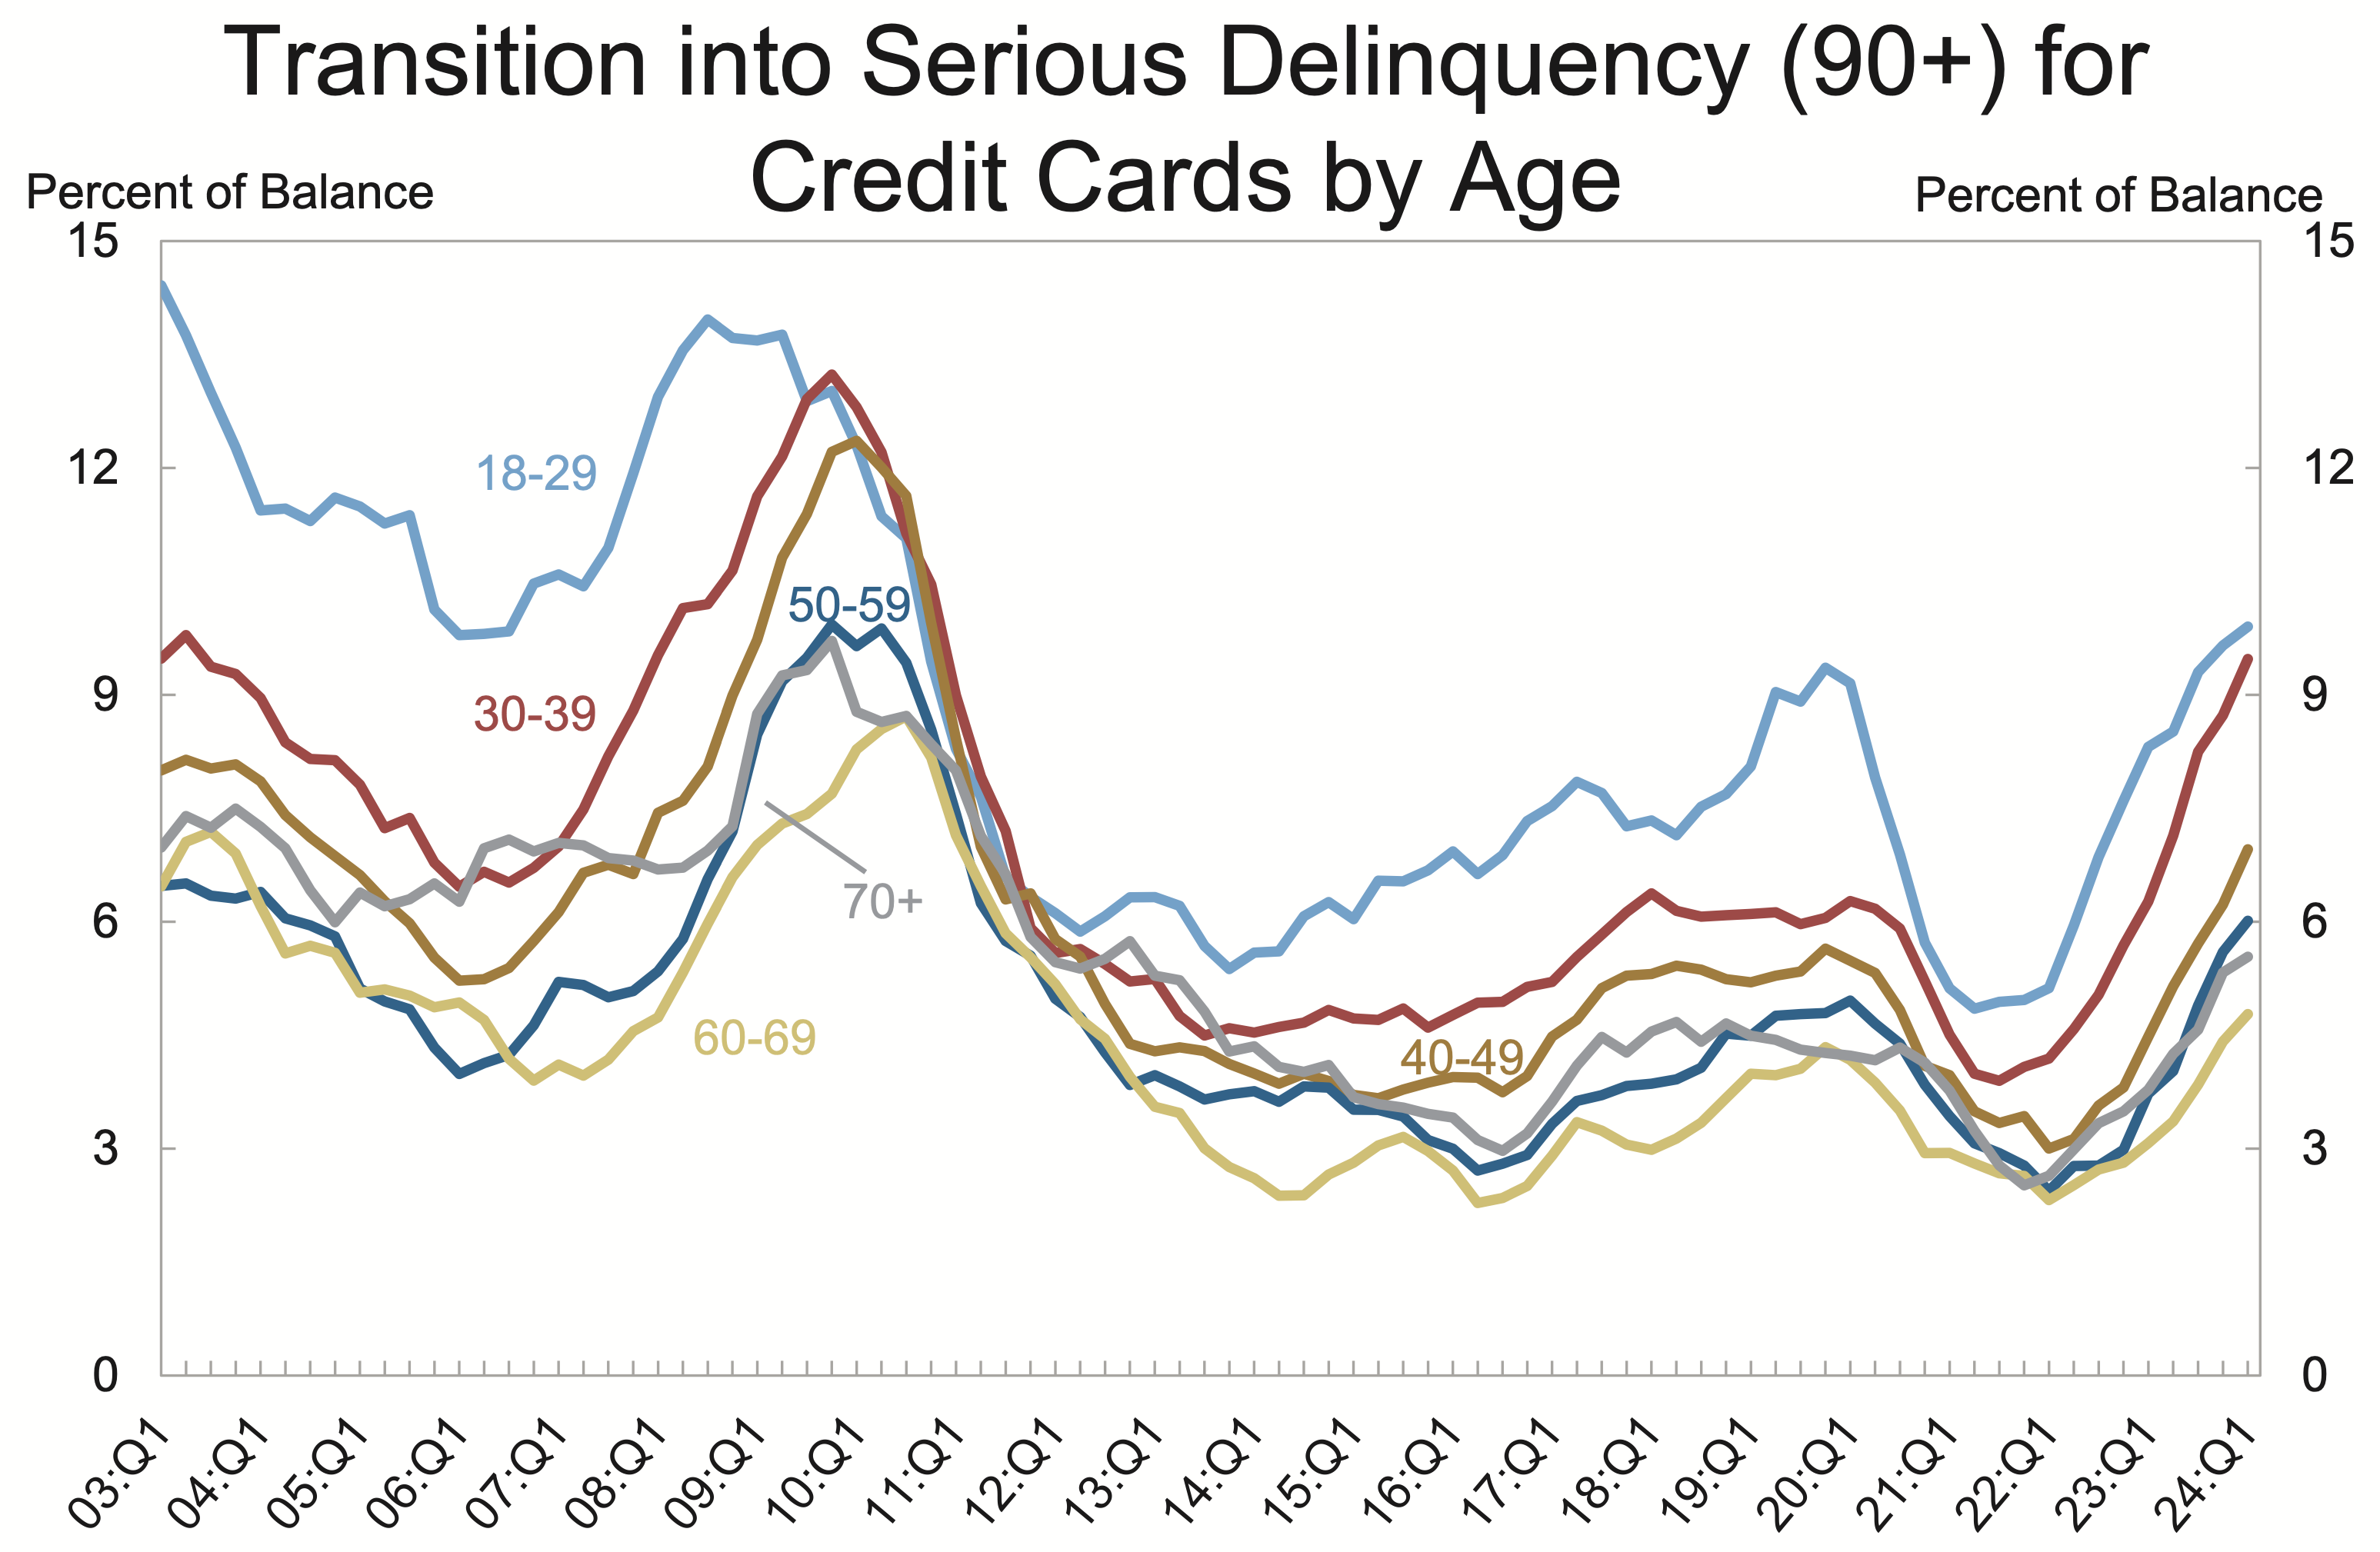
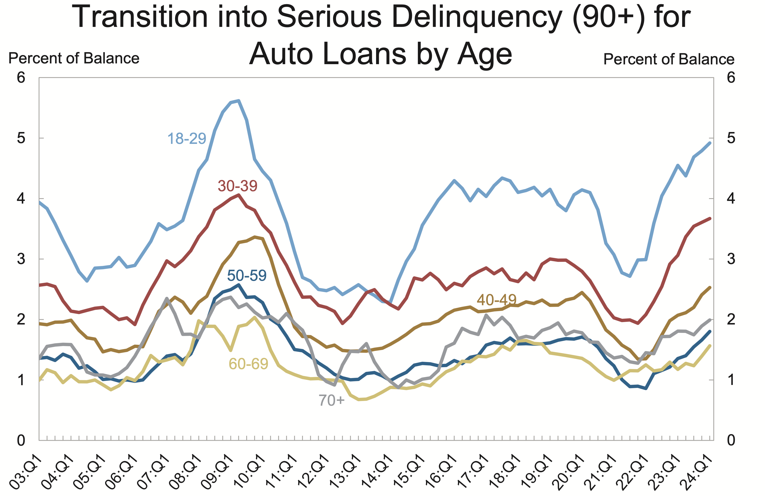
2Q 2024
2Q 2024
Source: Federal Reserve Bank of New York
The Economic Outlook Group

Slide 12
ON WATCH! • Weekly applications for unemployment benefits
• How high will the unemployment rate climb?
• Will take-home pay remain above inflation rate?
Real disposable personal income growth: positive but fading!
June 2023
5.3% YOY
Weekly applications for unemployment benefits since beginning of 2024.
August 2024
3.1% YOY
Oct, 10, 2024
231,000
Take-home pay
exceeds inflation
4-week moving averages
Take-home pay fails to keep
pace with inflation
Jan 6, 2024
204,000
Real disposable personal income, % change from year ago
Will employers accelerate layoffs?
CURRENT (4-week avg): 231,000
ECONOMY IS WEAKENING: 285,000
RECESSION LIKELY: 350,000+
How high will the jobless rate climb?
Sept. unemployment rate: 4.1%
ECONOMY IS WEAKENING: 4.5%
RECESSION LIKELY: 5.5%+
Sources: Bureau of Economic Analysis; Bureau of Labor Statistics via FRED
The Economic Outlook Group

Slide 13
Delinquency rates on Commercial Real Estate loans now highest in a decade!
Delinquency rates on CRE loans (excluding farmlands), booked in domestic offices, all commercial banks
2Q 2024
1.42%
March 2022
Fed begins to increase
interest rates
Source: Federal Reserve
The Economic Outlook Group

Slide 14
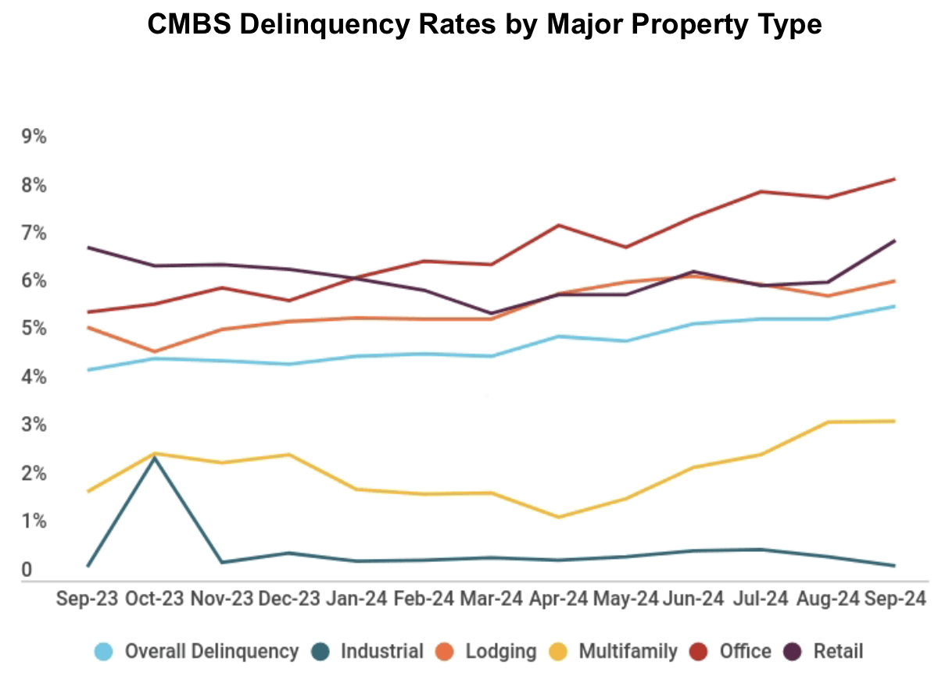
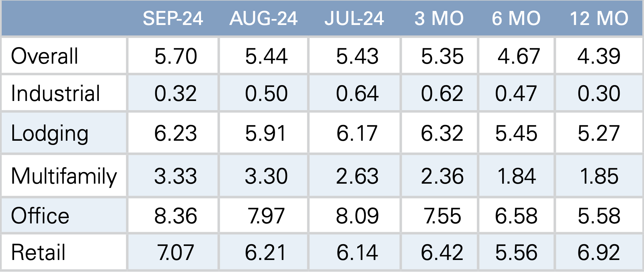
Office
Retail
Lodging
Overall
Multifamily
Industrial
CMBS delinquency rate by property type (% 30 days +)
Source: Trepp.com
The Economic Outlook Group

Slide 15
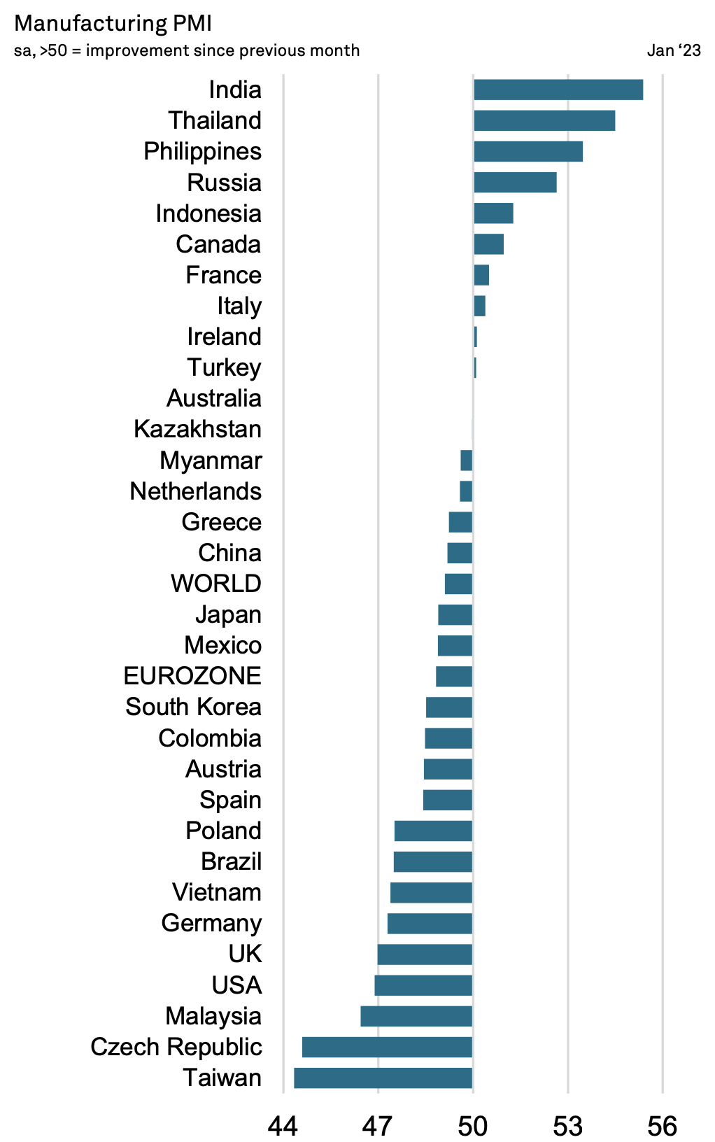
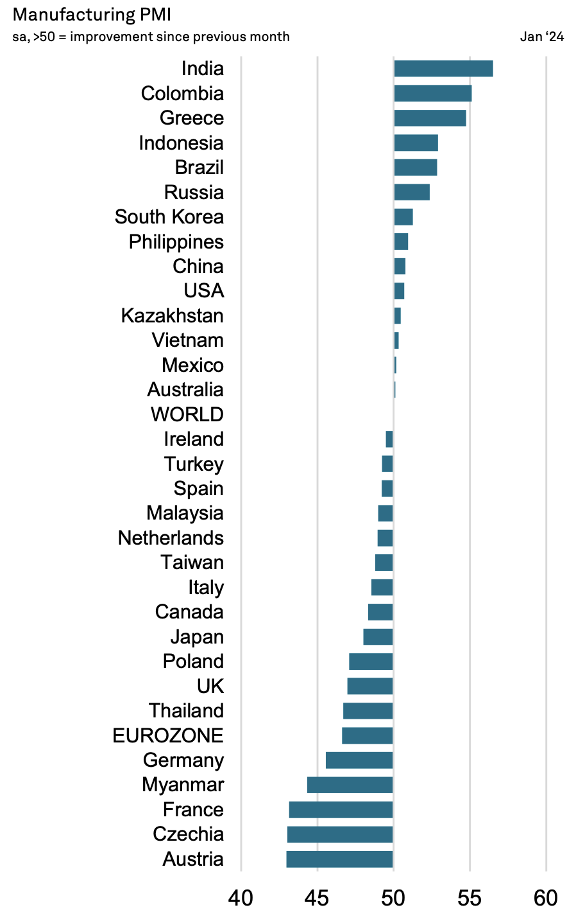
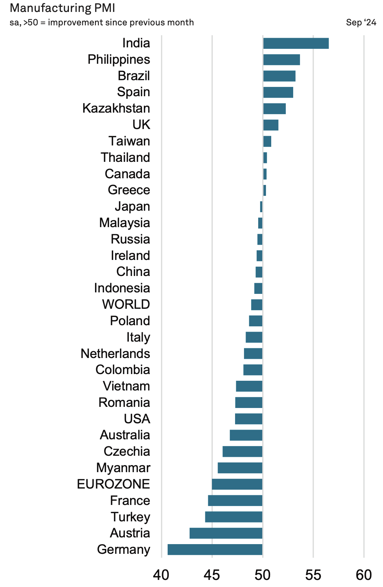
Source: J.P. Morgan Global Manufacturing PMI
v The Economic Outlook Group

Slide 17
Soft demand for manufactured goods has depressed input prices on many industrial commodities
Producer price index (PPI): Industrial Commodities, % change from year ago
Nov. 2021
+24.7%
Industrial commodities include…
Fossil fuels (e.g. diesel fuel = -36.0%, YOY)
Metals (e.g. steel mill products = -12.3%)
Lumber (- 0.6%)
Pulp & Paper products = (+2.1%)
Nonmetallic mineral products (+4.0%)
Chemicals (e.g. ethylene & propylene (+ 12.8%)
Sept. 20243
-3.32%
April 2020.
-9.14%
Source: Bureau of Labor Statistics
v The Economic Outlook Group

Slide 18
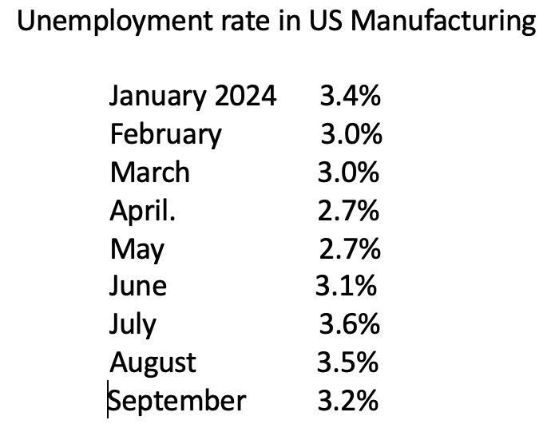
Despite sluggish manufacturing activity, job vacancies still exceed the number of unemployed.
Job openings
-- durable goods = 329,000
-- non-durable goods = 177,000
Job openings in manufacturing
August 2024 = 506.000
Unemployment in manufacturing
September 2024 = 481,000
Source: Bureau of Labor Statistics
v The Economic Outlook Group

Slide 19
Construction spending on manufacturing surged since passage of the
Investment in Infrastructure & Jobs Act (IIJA), Inflation Reduction Act (IRA), and CHIPS Act
Construction spending on manufacturing in the U.S.
(Monthly, in millions of dollars, annual rate)
Highlights: Construction spending on manufacturing in U.S.
• August 2024 = $238 billion (annual rate), an 85% jump
from two years ago!
• Which manufacturing industries are spending the most on construction?
--- Computers, Electronics & Electrical (63%)
--- Chemicals (19%)
--- Food, Beverage Tobacco (8%)
--- Transportation equipment (6%)
--- Other (4%)
CHIPS Act & IRA Act
August 2022
IIJA
Nov. 2021
Sources: U.S. Census via Federal Reserve; The Atlantic Council, February 13, 2024, “The IRA & CHIPS Act are Supercharging US Manufacturing
The Economic Outlook Group

Slide 20
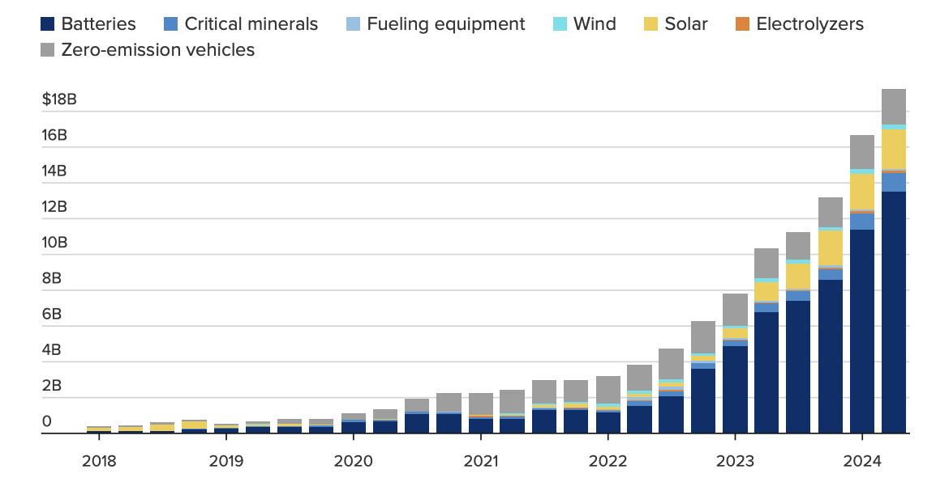
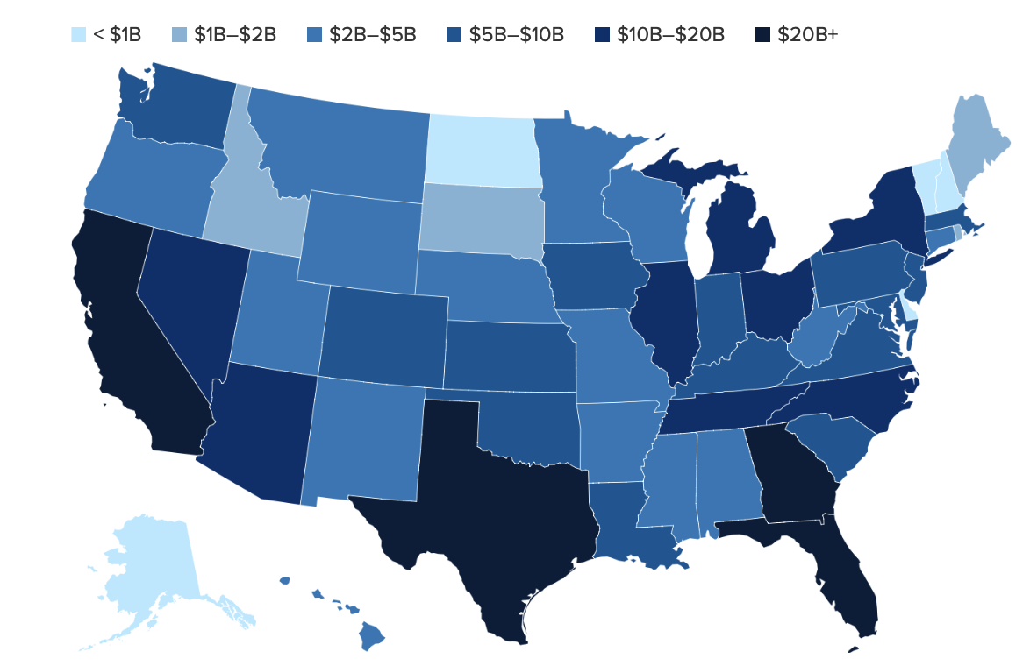
Actual investment in manufacturing for
clean energy technology in the U.S.
Geographic distribution in clean investment in
the two years since IRA passed
By type of technology: 1Q 2018 – 2Q 2024
Source: Massachusetts Institute of Technology and the Rhodium Group.

Slide 21
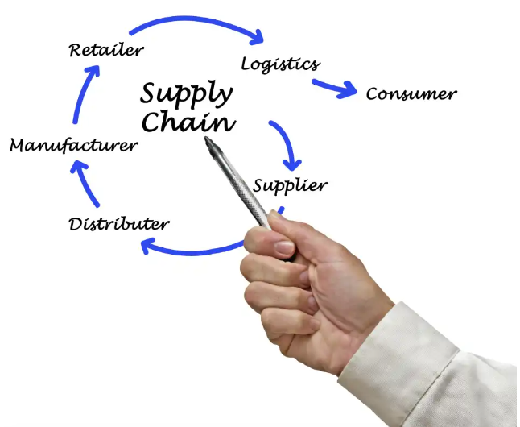
Pick your favorite term:
De-globalization, re-globalization, regionalization, friend-shoring, near-shoring, onshoring...
Problem: Multinationals struggle with the fragilities and uncertainties of current supply chain routes:
--> Tensions brewing with China over South China Sea & Taiwan
--> More destructive wars in the Middle East & Europe
--> Terrorists threats to navigation of the seas
--> A patchwork of US trade sanctions against Russia, Iran, China, North Korea…
--> Shipping firms pass on higher costs from insurance premiums to cleaner fuels.
--> Risk of future pandemics
Solution: Companies seek more simplicity, dependability and control over their supply chain.
• Preference to relocate factories from adversarial countries to friendlier venues.
• Combination of gov’t incentives and leading technologies have improved the economic calculus for domiciling plants.
--- New US legislation encouraging the domiciling of key industries for economic & national security reasons.
(e.g., Chips & Science Act of 2022; Inflation Reduction Act of 2022; Infrastructure Investment & Jobs Act of 2021 )
--- AI, robotics, 3D printing, cloud computing ---> can lead to a staggering jump in productivity.
• But…emerging markets still have some leverage over multinationals: “If you want to sell here, you have to build here!”
The Economic Outlook Group

Slide 22
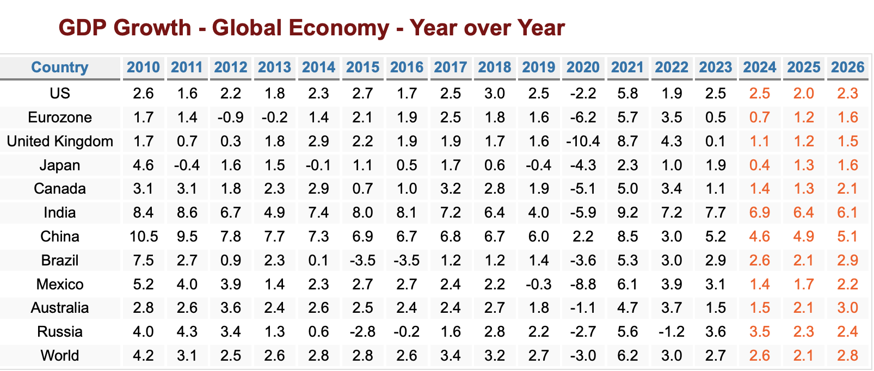
*
2024 - 2026
Growth leaders
India
Indonesia
Philippines
Thailand
China*
*China’s economic data
lacks credibility
2024 - 2026
Modest Growth
US
Australia
Canada
Russia
Brazil
Mexico
2024 - 2026
In or Near Recession
Eurozone (Germany)
United Kingdom
Japan
Argentina
The Economic Outlook Group

Slide 23
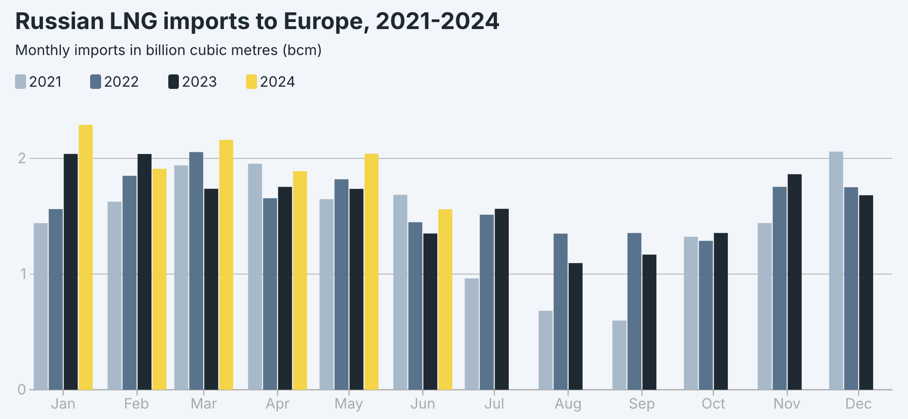
Not only are European Union members STILL allowed to import LNG from Russia,
they bought more in 1H of 2024 than in previous years!!
Source: INSTITUTE FOR ENERGY ECONOMICS AND FINANCIAL ANALYSIS
The Economic Outlook Group

Slide 24
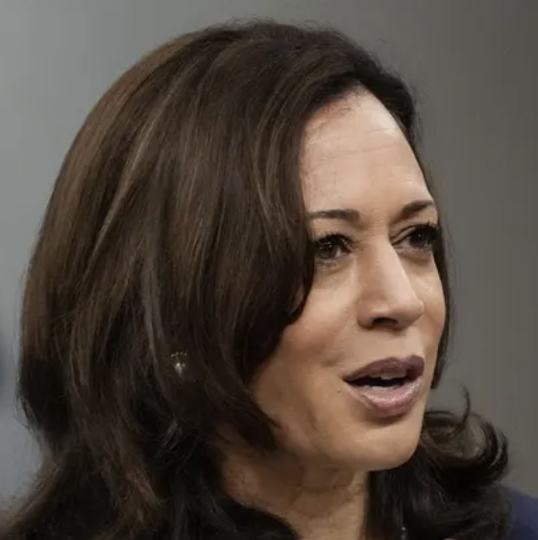
Vice President Kamala Harris
Trump Administration passed the Tax Cuts & Jobs Act in 2017.
* Cut top personal tax rate (from 39.6% to 37%); but it sunsets 12/31/25
* Corporate rate slashed (from 35% to 21%); has no expiration
Personal – Keep current tax rates for those making less than $400,000
• Above $400,000, restore top tax rate to 39.6%.
• Minimum 25% tax rate on wealthiest Americans (net worth above $100 million)
on broader definition of income (including unrealized capital gains).)
Capital Gains:
• Raise capital gains from 20% to 28% on taxable income that exceeds $1 million, plus 5%
investment tax.
Tax reductions:
• Expand child tax credit up to $3,600 per child; $6,000 for newborns in 1st yr.
• Ban tax on tips.
• Provide tax deductions of up to $50,000 for small business start-ups.
Corporate:
• Increase corporate tax rate from 21% to 28%
• Raise minimum tax rate on largest firms ($1 bill profits) 15% to 21%
Spending cuts:
Medicare to further negotiate reductions on prescription drugs.
Tariffs: Did not yet release her own detailed proposal, but has largely aligned herself to Biden’s policy on certain Chinese imports (e.g., 100% tariff on electric cars and 50% rate on solar panels.)
• Undo those Trump tariffs viewed as nonstrategic & inflationary.
Foreign policy: • Firmly opposes Russia’s actions in Ukraine • Pledges to defend Taiwan from Chinese attack, but doesn’t support Taiwan’s independence.
Former President Donald Trump
Personal – Make permanent 2017 individual income tax cuts;
Exempt social security benefits from income tax. Ban tax on tips.
Remove tax on overtime pay. Reinstate SALT deduction.
Corporate:
• Will further lower corporate tax rate from 21% to as low as 15% (for firms that
produce in the US).
• Seek greater deregulation, especially in the oil and gas industry.
Capital Gains:
No new tax policies proposed. Supports keeping tax on gains at 20%
Spending cuts:
Slash outlays on foreign aid and the Inflation Reduction Act (IRA), especially its environmental programs. “Reduce waste & fraud” from government spending.
Tariffs & Trade: Raise tariffs across the board
• 10% - 20% tariff on ALL US imports (even from Canada and Mexico)
• 60% tariff on US imports from China
• As much as 200% tariff on ALL Chinese motor vehicles imports made in Mexico
• 100% tariff on imports from countries that seek to shun the dollar.
Monetary policy:
Trump seeks a role in setting interest rates policy; Unlikely to reappoint Powell.
Foreign policy:
• Will not protect NATO allies who fail to meet their targeted defense spending.
• Has expressed little interest to support Taiwan in its conflict with China.
The Economic Outlook Group

Slide 26
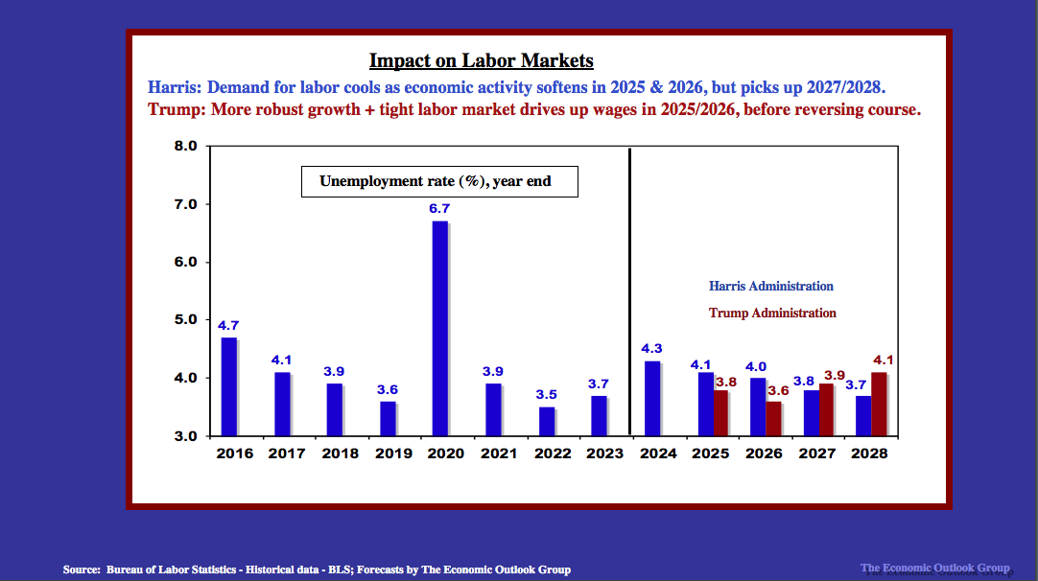

Slide 30
QUESTIONS OR COMMENTS?
bbaum@EconomicOutlookGroup.com

Slide 31
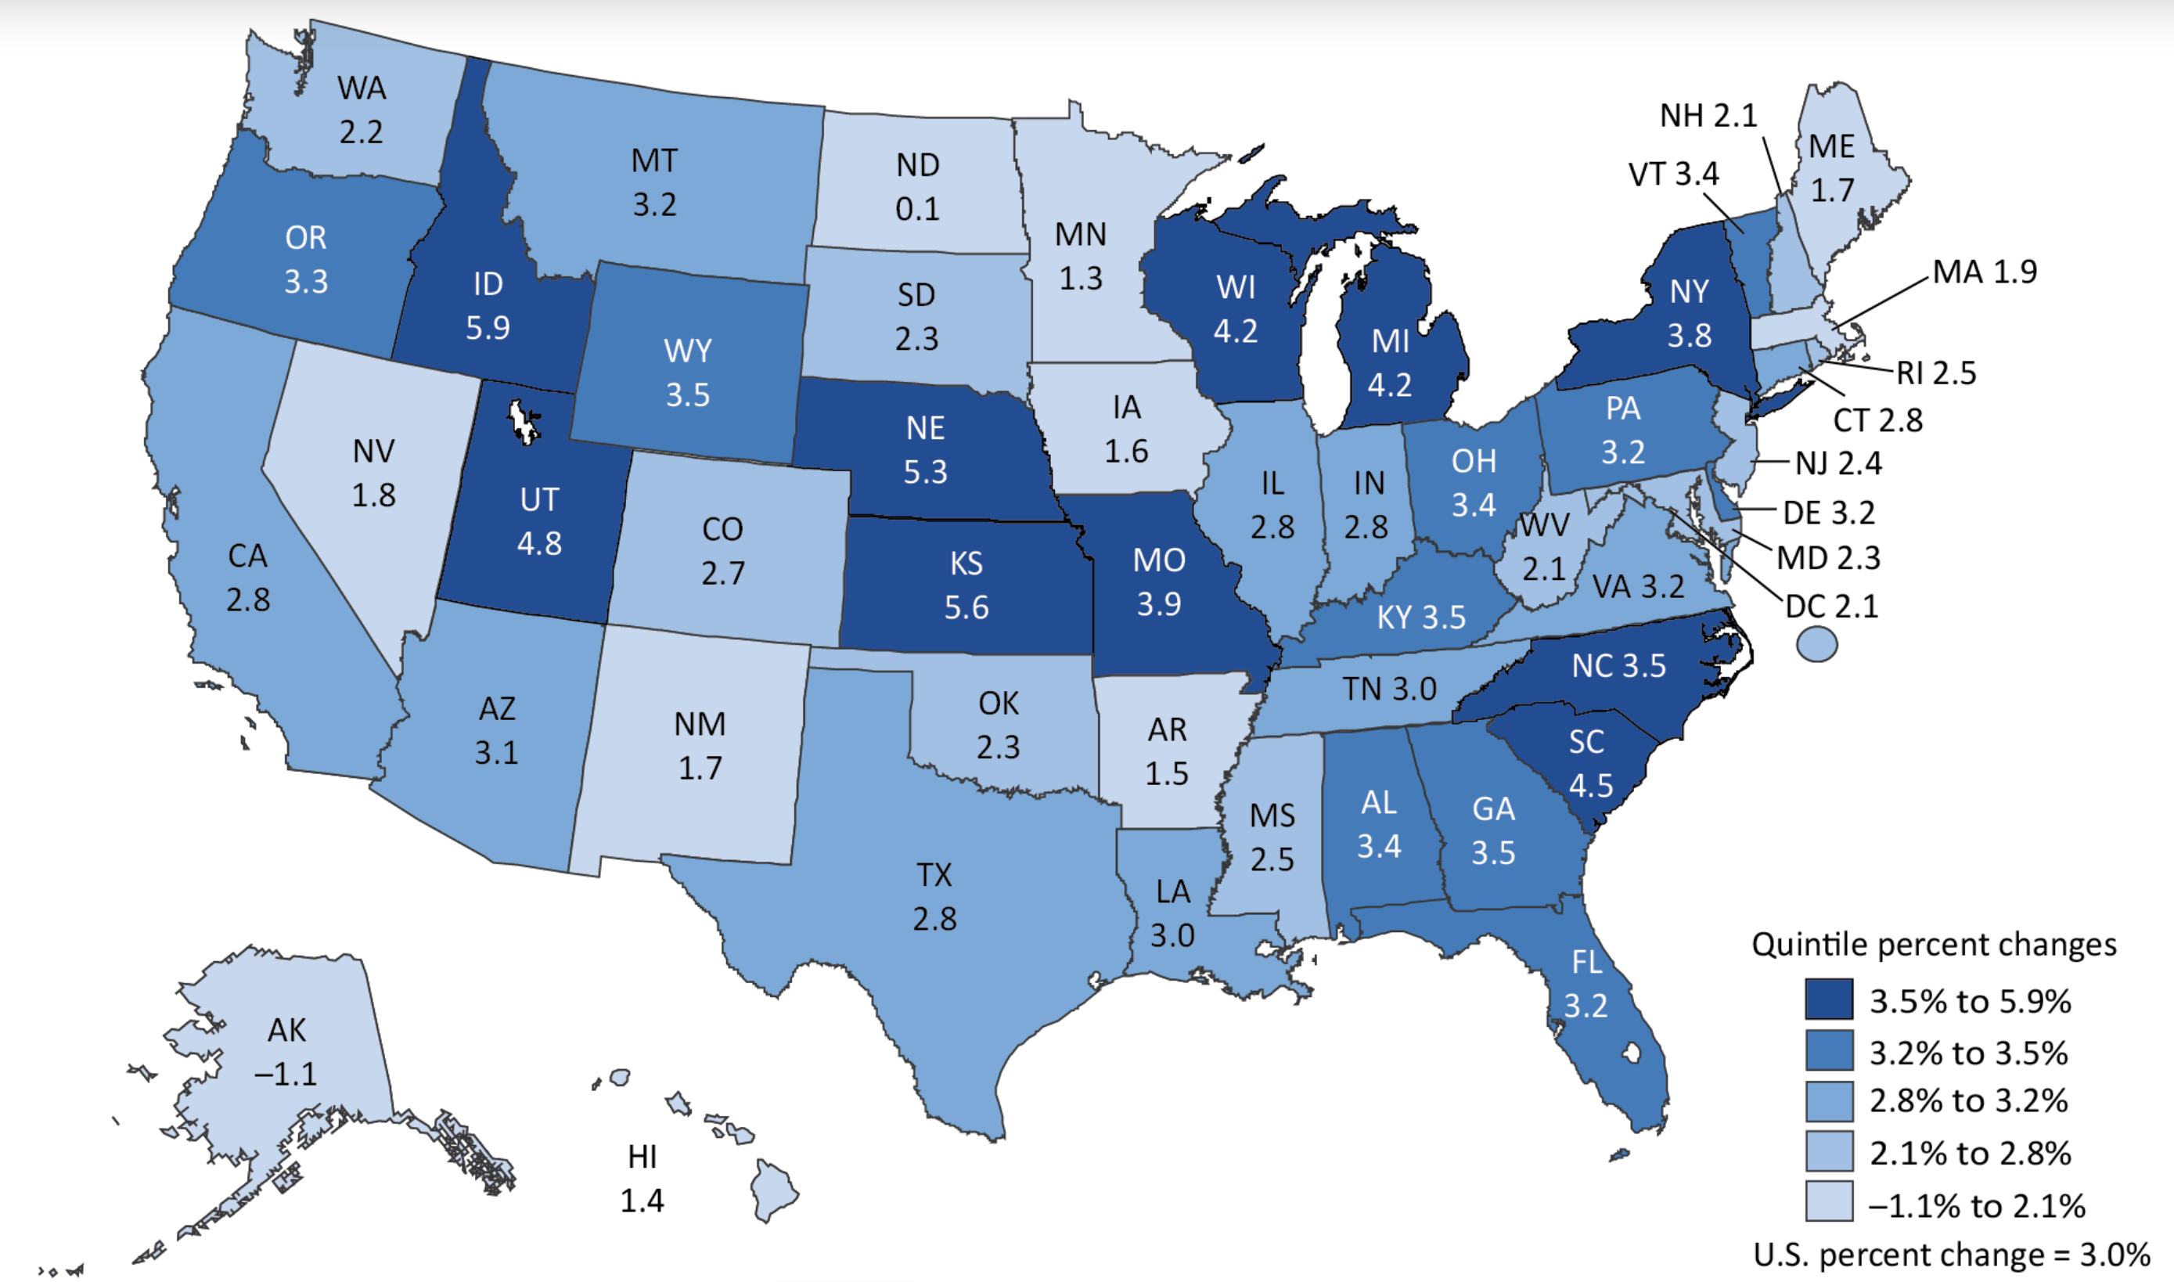
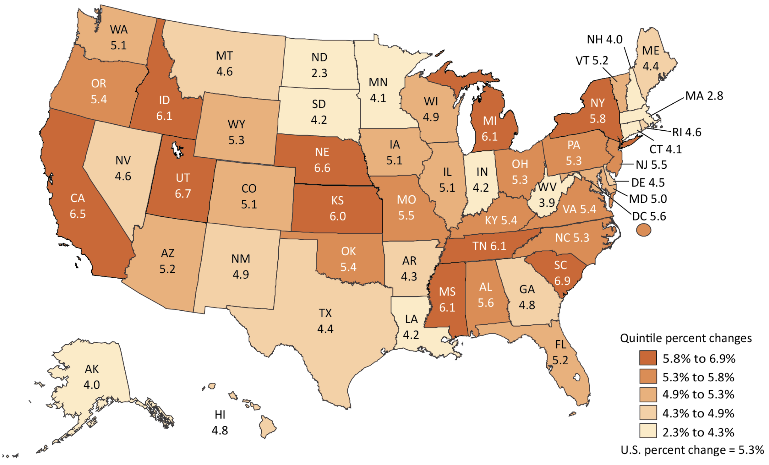
Real GDP growth by states: 2Q 2024
Personal income growth by states: 2Q 2024
Source: Bureau of Economic Analysis
The Economic Outlook Group

Slide 32
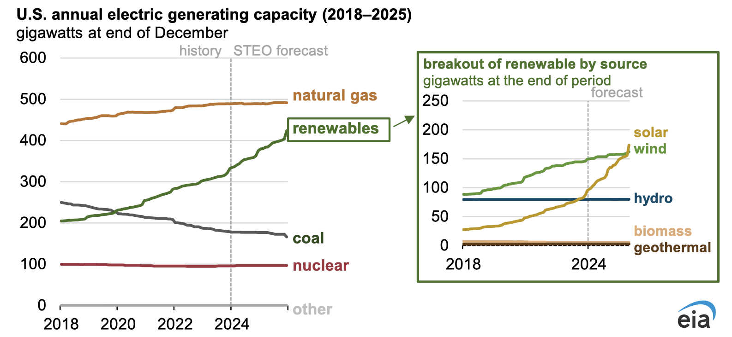
Source: U.S. Energy Information Administration
The Economic Outlook Group

Slide 33
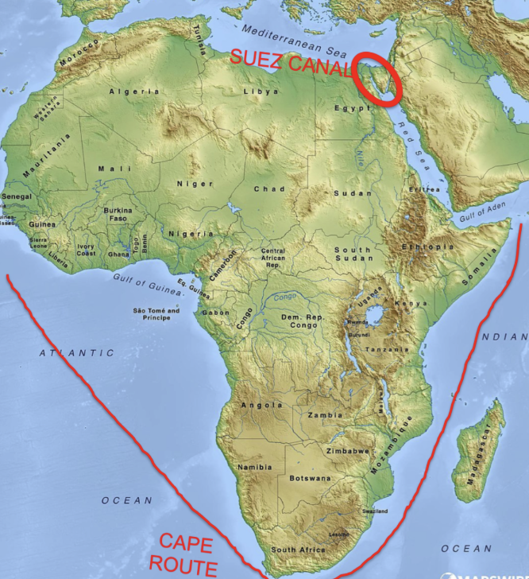
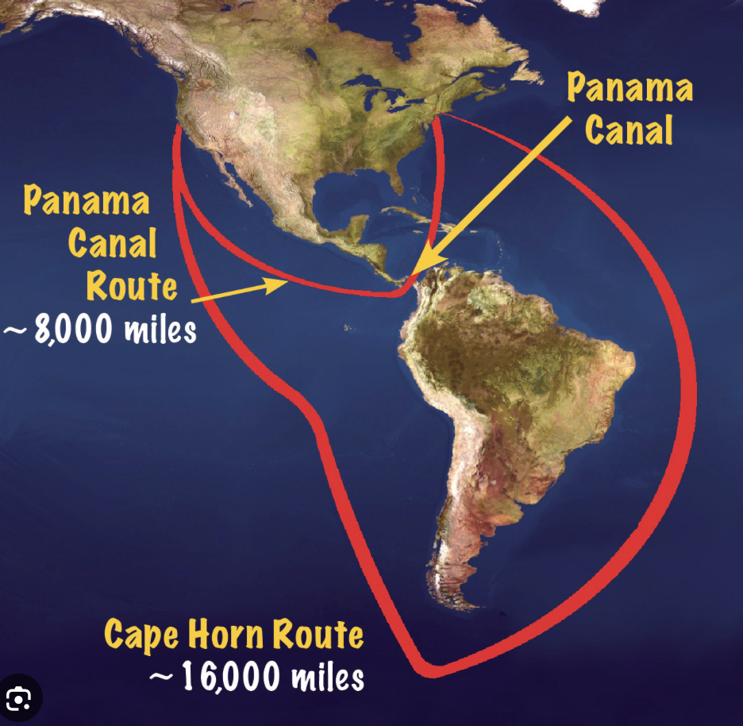
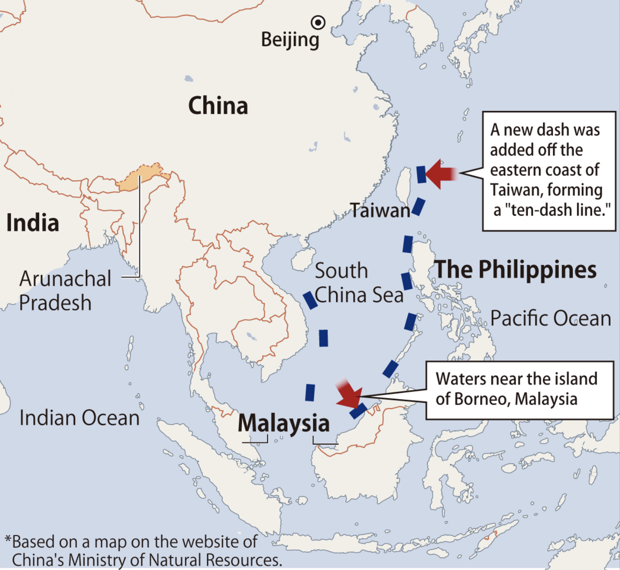
Houthi attacks in Red Sea & Gulf of Aden. Plans to strike ships in Indian Ocean too.
--12% of world trade cross this canal
--30% of global container traffic
--10% of oil trade (9.2 million bbl/day)
-- 8% of natural gas
• Ships that enter the Red Sea
pay costly “war insurance” premiums.
• More than 70% of ships chose to
re-route around Africa.
• Result: Adds 7 – 10 days to travel each way and $1 million more on fuel.
Global warming also affects shipping traffic.
• Example: Panama Canal restricted passage of ships in 2024 due to severe drought conditions.
• 5% of world maritime trade
• 40% of all US container traffic
• Passage slowed from about 36 - 38 ship crossings daily to about 27. Priority goes to highest bidder.
• Delays delivery of cars, fuel, food & other commodities
• More ships detour around longer South America
China’s “10-dash line” in South China Sea
It has the potential to choke off maritime traffic within SCS.
• 60% of world’s maritime trade transit the SCS
• 30% of all oil shipments
• 60% of all natural gas shipments.
• Country dependence on energy supplies via SCS:
South Korea 65%
Japan 75%
Taiwan 60%
China 80%
President Xi Jinping is determined to seize the “runaway province” of Taiwan.
Ordered his military to prepare such action by 2027.
Sources: CIA, US Commerce Department, International Maritime Organization; The Economic Outlook Group
The Economic Outlook Group

Slide 35
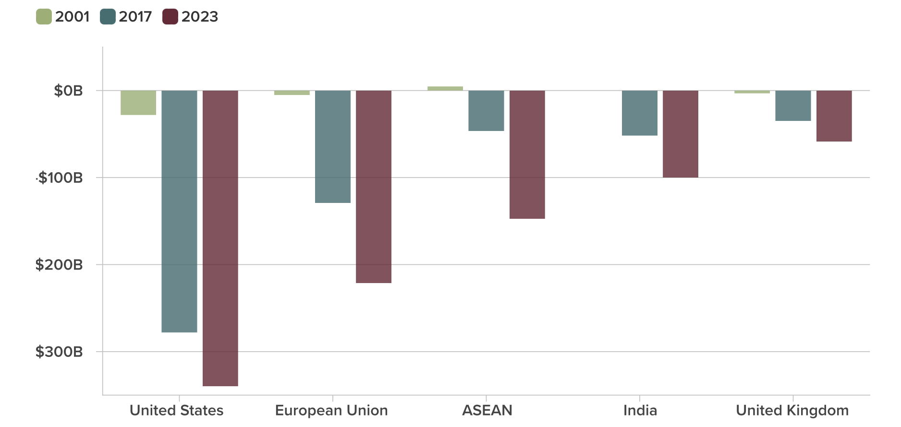
Trade deficits with China are STILL deepening for many countries
Trade balance with China
Sources: US Bureau of Economic Analysis; Eurostats, IMF, World Bank

