Slide 1

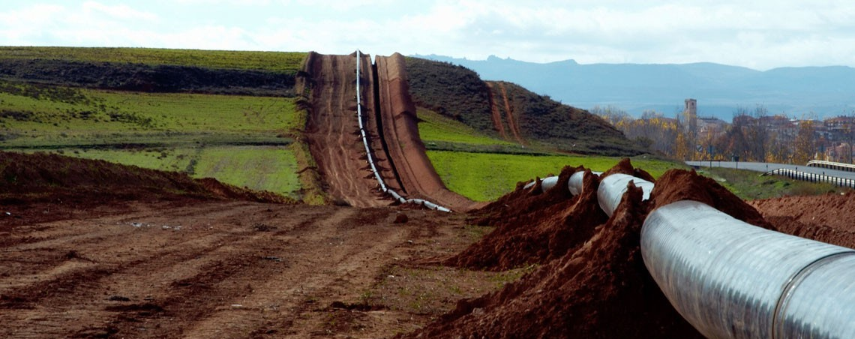
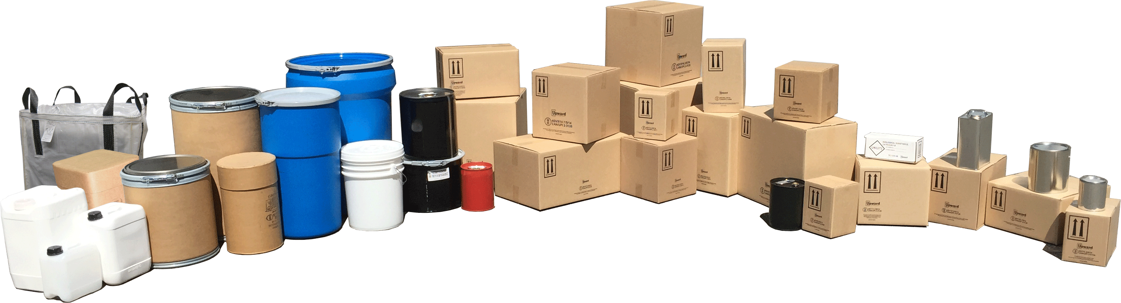

Systems Integrity Safety Program
Pipeline and Hazardous Materials Safety Administration
Overview Briefing

Slide 2

Presenter
Alex George
Senior Investigator/SISP Coordinator
Systems Integrity Safety Program
alex.george@dot.gov
Pipeline and Hazardous Materials Safety Administration
United States Department of Transportation
Office of Hazardous Materials Safety
230 Peachtree Street NW, Suite 2100
Atlanta, Georgia 30303
Mobile: (470) 653-8241

Slide 3



Who is PHMSA?
The Pipeline and Hazardous Materials Safety Administration (PHMSA) is a U.S. Department of Transportation agency responsible for ensuring the safe and secure movement of hazardous materials across the country’s transportation systems.
Notes:
PHMSA regulates over 1 million daily shipments of hazardous materials and oversees the nation’s extensive pipeline network.

Slide 4
Key Responsibilities:
Regulation and Oversight
Prevention and Preparedness
Safety Innovations
Notes:
Regulation and Oversight: Which allows PHMSA develops national policy, sets safety standards, and enforce regulations for transporting hazardous materials.
Prevention and Preparedness: where PHMSA works to prevent transportation incidents and prepare first responders for potential emergencies.
Safety Innovations: Through partnerships with industry stakeholders, which is where PHMSA encourages innovative practices to enhance the safety and integrity of the nation’s transportation infrastructure.
Most of us in the room are familiar with the first Responsibility because we have either had an inspection or have known of an individual who has had an inspection.

Slide 5
PHMSA’s Mission and the Connection to SISP

Slide 6


PHMSA’s Mission: Advancing Safety in Hazardous Materials Transportation
PHMSA’s mission is “to protect people and the environment by advancing the safe transportation of energy and other hazardous materials that are essential to our daily lives.”

Slide 7

Mission Goals in Relation to SISP:
Risk Reduction
Collaborative Safety Efforts
Enhancing Public Safety
Notes:
This is accomplished by the three overall goals of SISP which are:
Number 1) Risk Reduction: SISP supports PHMSA’s mission by identifying and addressing systemic safety issues before they result in incidents.
Number 2) Collaborative Safety Efforts which allows us to work with regulated entities to promote compliance and implement best safety practices across the industry, particularly focusing on high-risk activities.
And Number 3) Enhancing Public Safety: By fostering partnerships through SISP, which allows PHMSA to enhance the safety of the public, workers, and the environment by ensuring that hazardous materials are transported securely and responsibly in an alternative manner outside of traditional enforcement.

Slide 8
Introduction to the Systems Integrity Safety Program (SISP)

Slide 9
What is the Systems Integrity Safety Program (SISP)?
The Systems Integrity Safety Program (SISP) is a proactive initiative developed by PHMSA to ensure the safe transportation of hazardous materials. As a dedicated resource within the Office of Hazardous Materials Safety Field Operations (OHMSFO), SISP coordinates risk-based national inspections and implements alternative enforcement strategies. Focusing on systemic safety, SISP goes beyond traditional inspections by conducting comprehensive reviews of businesses' practices involved in hazardous materials transportation, to enhance overall safety and prevent incidents.

Slide 10
Why SISP Matters:
SISP is essential for both safety and business efficiency. By addressing root causes of non-compliance and promoting best practices, the program helps minimize risks, prevent costly incidents, and improve the industry’s overall safety culture. For businesses, especially small and mid-sized organizations, participation in SISP can lead to improved operational efficiency and regulatory peace of mind.

Slide 11
Key Points of SISP
Proactive Safety Approach:
2. Data-Driven Risk Based Inspections:
3. Regulatory Compliance for Safer Operations:

Slide 12
Eligibility and Selection
Notes:
So what makes a company eligible for SISP?

Slide 13
Eligibility Criteria
To qualify for SISP participation, regulated entities must meet one or more of the following criteria within the past five years:
Involvement in over three separate PHMSA civil enforcement cases, five enforcement actions, or multiple warning letters.
Identified through adverse safety trends based on incident and inspection data, or high-risk activities such as:
  Over 50 hazardous materials incidents involving non-bulk packaging (49 CFR Part 172.504, Table 2).
  More than three incidents involving intermediate bulk or portable tank packaging (Table 2 materials).
  More than one incident involving high-risk materials (Table 1) in non-cargo tank packaging.
  One or more serious hazardous materials incidents outside cargo tanks or railroad cars.
  Recommended or ordered safety recalls by PHMSA for packaging or materials.
  Directed by the Director of Outreach and Engagement or Associate Administrator for hazardous materials safety.
Notes:
Eligibility for SISP programs is based on analysis regarding:
Incident History
Compliance History
Adverse safety trends
As Directed by O&E Director, DAAFO or designee, or the Associate Administrator for Hazardous Materials Safety.
Probability of incidents
Consequence to life, property, environment
Measured risk factors
Stakeholder assistance

Slide 14
What are the Benefits of Participating?
Notes:
What are the Benefits of Participating in SISP and Why should my Business Join? (next slide)

Slide 15

Why Should a Business Join SISP?
“I’m from the Government, and I’m here to help”
President Ronald W. Reagan
August 12, 1986
Notes:
Simply put because I’m from the Government and I’m here to help ( no but really) ( next slide)

Slide 16
Why Should a Business Join SISP
By participating in SISP, businesses can work directly with PHMSA to improve safety practices without fear of punitive enforcement. The program promotes collaboration, offering tailored guidance and support to help businesses meet compliance standards.
Notes:
Why Join?
Collaborative Approach: Work with regulators, not against them, to improve safety.
No Routine Enforcement: Inspections paused, focusing on cooperation and support.
Custom Safety Solutions: Tailored improvements that can boost overall safety and compliance.
Low Risk, High Reward: Focused on improvement, not penalties—great for businesses aiming to proactively manage risks.

Slide 17
Key Points of the Agreement:
Agreement Document:
Safety Program Plan:
Site & Documentation Reviews:
Confidentiality Agreement:
Key Timelines:
Notes:
Agreement Document: Formal contract outlining roles, responsibilities, and scope.
Safety Program Plan: Customized plan developed with PHMSA to improve compliance.
Site & Documentation Reviews: PHMSA conducts reviews, and deficiencies are corrected.
Confidentiality Agreement: Ensures sensitive business information is protected.
Key Timelines: Clear milestones for site visits, corrective actions, and final reports.

Slide 18
Remember
Participation is not an express or implied admission of any fault or violation of law or regulation.

Slide 19

Questions?
Notes:
The presenter should provide detailed information in presenter notes

Slide 20

Contact Information
  For additional information, please contact any member of the team or the Field Outreach Coordinator
  SISP Coordinators
  Stuart Streck – stuart.streck@dot.gov
  Kimberly Flores – kimberly.flores@dot.gov
  Terry Pollard - terry.pollard@dot.gov
  Alex George – alex.george@dot.gov
  Kimberly Yoder –Kimberly.Yoder@dot.gov
  Director of Field Outreach & Engagement
  Marc Nichols - marc.nichols@dot.gov
  For additional details on the SISP program, please view our web page
Notes:
The presenter should provide detailed information in presenter notes

