Slide 1
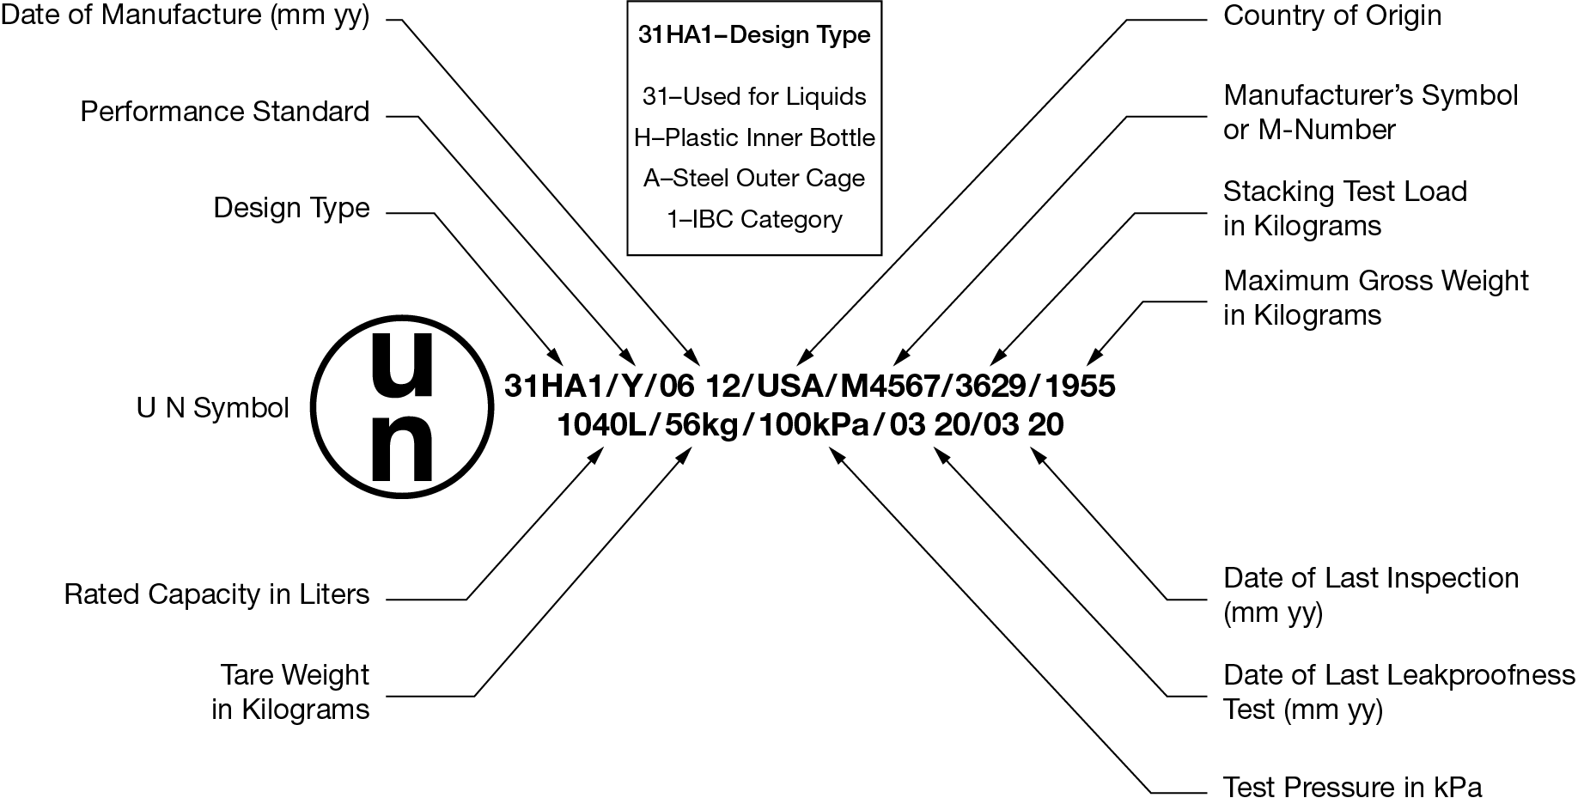
RIPA IBC Compliance Workshop: 2020
An introduction to IBC regulations in the U.S.

Slide 2
IBC Compliance Workshop: 2020
About RIPA
The Reusable Industrial Packaging Association was created in 1943 to represent businesses that collect and recondition steel drums.
Today, the association represents about 70 reconditioners that operate 180 facilities throughout North America, including about 25 Supplier members and companies operating around the world.
Members in the U.S. recondition about 60 million steel drums, plastic drums and IBCs annually.
RIPA represents its members before Congress and various regulatory agencies, including DOT & EPA.

Slide 3
IBC Compliance Workshop: 2020
RIPA is a founding member of the International Confederation of Container Reconditioners (ICCR), which represents the association at –
  UN Sub-Committee of Experts on the Transport of Dangerous Goods
  International Organization for Standards
ICCR members come from –
  Japan (JDRA)
  European (SERRED)
  North American (RIPA)
  South Africa (SAICRA)
  China

Slide 4
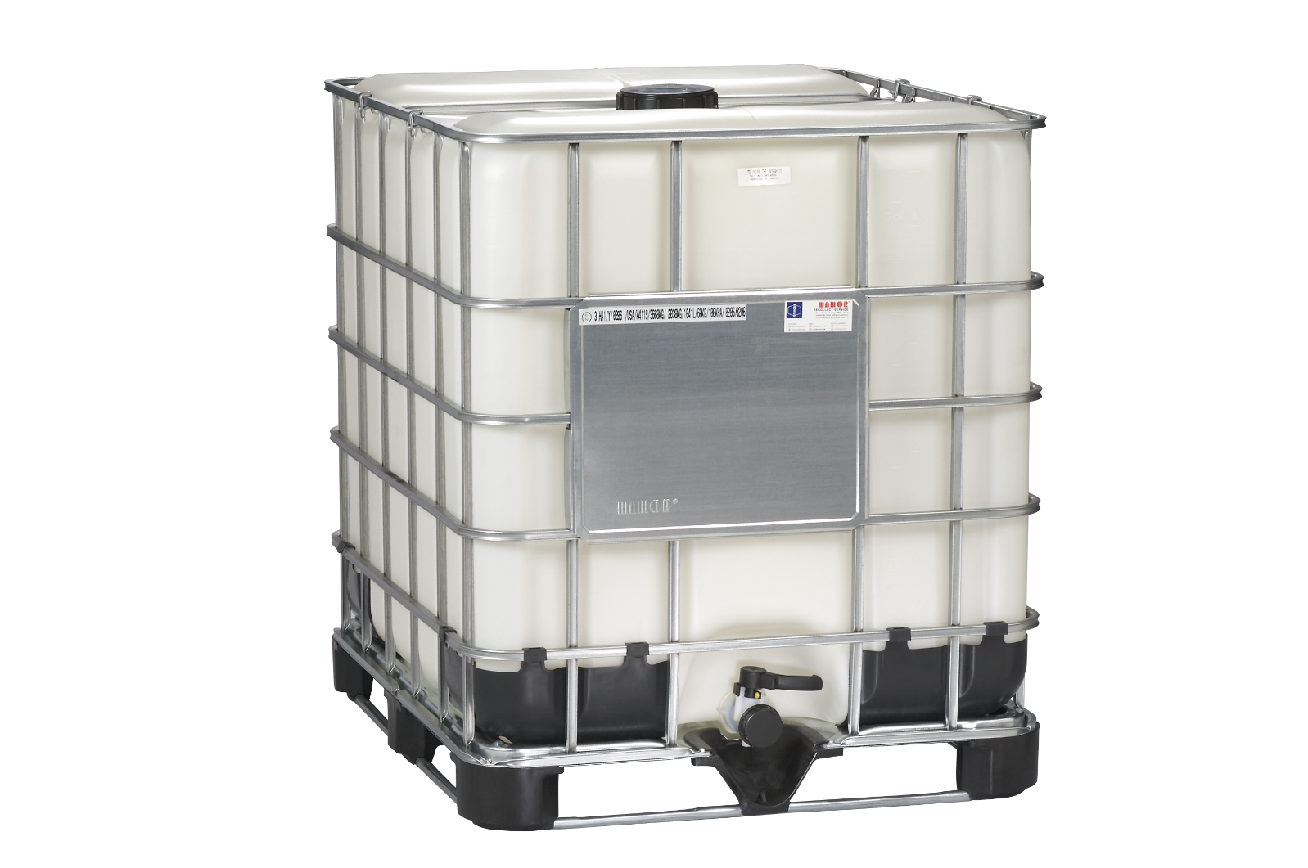
IBC Compliance Workshop: 2020
Focus of webinar is on composite IBC regulations and compliance.
Most common capacities are 275- and 330-gallon

Slide 5
IBC Compliance Workshop: 2020
IMPORTANT DEFINITIONS FOR IBC REPROCESSSORS
DID YOU SAY “IBC REPROCESSOR?”
YES!
DOT does not use the term “reconditioning” for IBCs. IBCs are -
    “routinely maintained”
    “repaired” or
    “remanufactured.”

Slide 6

IBC Compliance Workshop: 2020
Terminology
Throughout this presentation we will –
- Use the term “reprocessor” to refer to reconditioning facilities
- Use the term “bottle” interchangeably with “inner receptacle.” DOT regulations use “inner receptacle.”

Slide 7
IBC Compliance Workshop: 2020
Definitions
Routine maintenance
The IBC is -
    cleaned, with closures reinstalled or replaced in conformance with the original manufacturer’s specifications.
    OR
    has its structural equipment restored.
Example: Structural equipment includes reinforcing or handling parts, or load bearing structural members (such as legs). These items can be bent or fixed (not welded) to ensure the IBC is safe for transportation.

Slide 8
IBC Compliance Workshop: 2020
Repaired IBC
A metal, rigid plastic or composite IBC that is restored to conform to the design type and is able to withstand the design type tests.
IMPORTANT
The inner receptacle of a repaired IBC may be replaced [only] with another inner receptacle of the same design from the original manufacturer.
Key Terms
IBC design type:
An IBC that does not differ in structural design, size, material of construction, wall thickness, manner of construction and representative service equipment.
Note: (1) Corner protectors are part of a design type
(2) Service equipment includes filling and discharge valves, pressure relief valves, fill caps, safety and heating devices.
Example
Mauser 275-gallon IBC. In a repair operation, when replacing the bottle, you MUST use another Mauser bottle of the same design. The replacement bottle may be new or cleaned.

Slide 9
IBC Compliance Workshop: 2020
Remanufactured IBC
(Commonly called “cross-bottling”)
A composite IBC that -
Has an inner receptacle produced by one manufacturer, which is placed into a cage produced by another manufacturer.
Example
A Schuetz bottle is placed into a Mauser cage. Companies must have a test report.

Slide 10
IBC Compliance Workshop: 2020
Design Type Test Reports
RIPA administers an IBC design type testing program on behalf of participating members every year.
Bottle/Cage | Pallet | Capacity (gal.) | Mark | Corner Protector
Schuetz Bottle/ Mauser Cage | Mauser SM 13 Composite | 330 & 275 | Y/1.6/70 | YES
Schuetz Bottle/ GBCG-Cube Cage | G-Cube Composite Poly | 330 & 275 | Y/1.6/70 | YES

Slide 11
Ibc compliance workshop: 2020
IBCs that have been emptied by a customer are often not absolutely empty; they still hold small amounts of hazmat residue.
IBCs with HazMat residue (e.g. chemicals, paints, etc.) must be properly transported and managed at your facility.
Empty IBC Rule
and
Transportation Requirements

Slide 12
IBC Compliance workshop: 2020
IMPORTANT
Two federal agencies regulate different aspects of IBC transportation:
U.S. Department of Transportation (DOT) and
U.S. Environmental Protection Agency (EPA)

Slide 13
IBC Compliance workshop: 2020
EMPTY IBC REQUIREMENTS
EPA rule (40 CFR 261.7)
The Environmental Protection Agency (EPA) has limited the amount of regulated residue allowed in an “empty” drum or IBC. The rule states -
  All residues must be removed that can be removed (by the emptier!)
OR
  0.3% by weight of total capacity (about 0.81 gal. for 275-gallon unit)

Slide 14
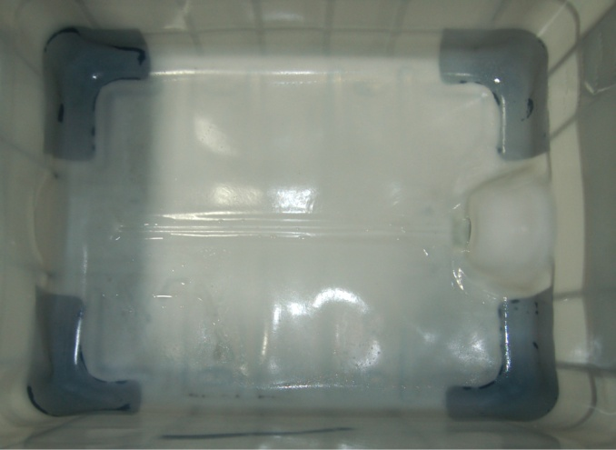
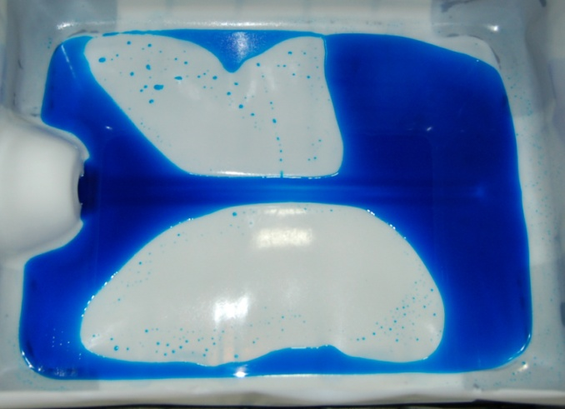
Ibc compliance workshop: 2020
No Liquid
0.81 gallons

Slide 15
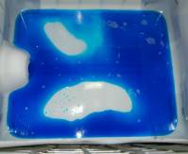

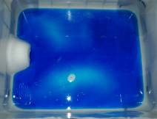

IBC Compliance workshop: 2020
3 gallons/Not RCRA-empty
5 gallons/Not RCRA-empty

Slide 16

IBC Compliance Workshop: 2020
DOT REQUIREMENTS FOR TRANSPORTATION OF EMPTY IBCs
The shipper/emptier must be sure:
Openings are closed (e.g. cap, valve)
Labels are in place
Truck is placarded on four sides (four-digit UN ID for each material)
Driver is given proper shipping papers
Driver has hazmat endorsement
Empty container certification is signed

Slide 17
IBC Compliance workshop: 2020
Empty Container Management is serious business!
These are actual headlines from the Milwaukee Sentinel Journal
BURNED: Chemicals in barrels leave workers and neighborhoods at risk
- Milwaukee Journal Sentinel, February 15, 2017
WISCONSIN DNR Says Milwaukee industrial barrel plants broke environmental laws
- Milwaukee Journal Sentinel, July 25, 2017

Slide 18
IBC Compliance workshop: 2020
EMPTY IBC CERTIFICATION
RIPA recommends using the RIPA “Empty IBC Certification” form for every shipment going to your facility.
Purpose -
  Emptier/shipper must sign and take responsibility for compliance with RCRA empty container rule.
  Proof to EPA/DOT that you have done your part to eliminate “heavy” containers.
  Proof to emptier/shipper if problems arise.

Slide 19
IBC Compliance Workshop: 2020
SAMPLE SAMPLE SAMPLE
EMPTY CONTAINER CERTIFICATION FORM
I hereby certify that each of the containers in this shipment is “empty” as that term is defined in Environmental Protection Agency regulations (40 CFR 261.7), meaning that all contents have been removed that can be removed using practices commonly employed to remove materials from containers of this type, and for containers larger than 119 gallons in size, no more than 0.3 percent by weight of the total capacity of the container remains in the container.
Furthermore, the containers have been properly prepared for transportation under the regulations of the U.S. Department of Transportation (49 CFR 173.29).**
The undersigned also (i) agrees that title to the containers does not pass to [reconditioner name] until the containers are unloaded, inspected, and accepted for reconditioning; (ii) acknowledges that non-empty containers will be rejected; and (iii) agrees that non-empty containers will be retrieved by the company on whose behalf the undersigned signs this certification.
Name: _____________________________________ Position: ______________________________
Company: _________________________________ Date: _____/______/______
Phone: (_____)______________________ E-mail: ________________________________
SIGNATURE: _____________________________________________
For residues of “P–list” products specifically listed by name in 40 CFR 261.33 (e), the container is empty only if it “. . . has been triple-rinsed using a solvent capable of removing the product,” or has been cleaned by another method shown to achieve equivalent removal.
**DOT’s 49 CFR 173.29 requires that all openings on the empty container must be closed, and that all markings and labels must be in place as if the drum were full of its original contents.

Slide 20
Ibc compliance workshop: 2020
California Empty Container Rule
Companies doing business in California should create an empty container certificate that specifically refers to the California Contaminated Container Regulations, Title 22 Section 66261.7. This provision states that a container which previously held hazardous materials is empty if:
No material can be poured or drained from the container when it is held in any orientation (e.g., tilted, inverted, etc.),
No material remains in or on the container that can feasibly be removed by physical methods which are commonly employed to remove such materials. The interior of the container should not contain crusted or a mass of solidified material.

Slide 21

Ibc compliance workshop: 2020
Managing Incoming IBCs

Slide 22
IBC Compliance workshop: 2020
Incoming New IBC Bottles
When receiving new IBC bottles, RIPA recommends a six-sided visual inspection be performed on each bottle by a trained plant employee after it is removed from the delivery truck.
Purpose: Check for damage caused in transit that may cause the bottle to be unusable.
INCOMING IBCs

Slide 23

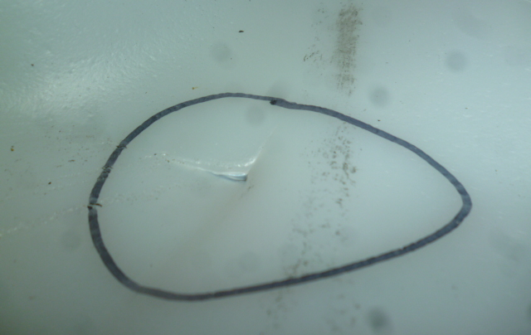
IBC Compliance workshop: 2020
- Incoming Bottle Issues

Slide 24
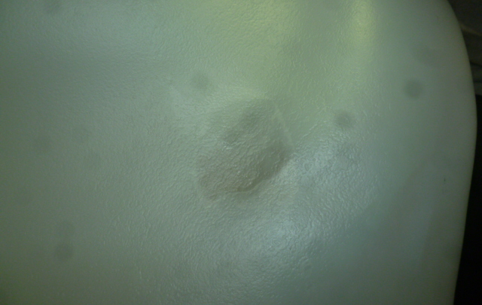

IBC Compliance workshop: 2020
- Incoming bottle issues

Slide 25
Ibc compliance workshop: 2020
DOT Special Permit 16323
DOT will grant reprocessing companies “party-to” status to DOT-SP 16323, but you must apply to DOT. See Appendix VII of the Manual.
This Special Permit entitles the holder to install a tested inner receptacle of a composite IBC into an outer cage without performing a leakproofness test after installation.
Reprocessing companies that utilize this Special Permit must apply a sticker to each IBC produced using this authorization.
IMPORTANT: Employees must be trained to apply the sticker.
DOT-SP 16323

Slide 26

Ibc compliance workshop: 2020
How to Manage Non-RCRA-empty IBCs
Customers occasionally mistakenly ship IBCs to you that contain more than allowable amounts of hazmat residue. Members should have a written procedure in place to deal with these units, and employees should be trained in these procedures.
RIPA has developed facility operating guidelines for the inspection and management of incoming containers, including IBCs.

Slide 27
Ibc compliance workshop: 2020
Each load of incoming IBCs should be accompanied by a signed empty container certificate
01
Each unloaded IBC should be visually inspected to determine if it is empty
02
If an IBC is not RCRA-empty, a “rejected” label should be applied in a visible location
03
Non-empty containers should be placed in a designated holding area, which is regularly inspected

Slide 28
Reconditioning Facility Guidelines for the inspection and management of incoming containers
The customer sending the non-compliant container should be contacted to arrange for its removal
The reprocessor should keep a record of the customer, date and time of call
The reprocessor should work closely with the customer to ensure the non—compliant IBC is returned promptly and in conformance with all applicable regulations
The reprocessor should keep all records of non-conforming container issues for three years

Slide 29
Understanding IBC Markings

Slide 30
Ibc compliance workshop: 2020
IBC Marking
All marks must be 12 mm high (about ½ inch)
“Primary Mark”
UN 31HA1/Y/07 20/USA/M 4567/3629/1955
    UN 31HA1 design type
    Y performance standard
    07 20 date of manufacture
    USA country of manufacture
    M 4567 manufacturer symbol/”M” number
    3629 stack test load in kilograms
    1955 maximum gross weight in kilograms

Slide 31
IBC Compliance workshop: 2020
IBC Marking (cont,)
“Additional Mark”
1040L/56kg/100kPa/07 20/07/20
    1040L Rated capacity in liters
    56kg Tare weight in kilograms
    100kPa Test pressure in kilopascals
    07 20 Date of last leakproofness test
    07 20 Date of last inspection

Slide 32
IBC Compliance Workshop: 2020
Bottle Marking
31HA1/M4567/03 20/USA
  31HA1 IBC design code
  M4567 Name or symbol of manufacturer
  03 20 Date of manufacture
  USA Country authorizing mark
    Issue: The mark on bottle not always in the
    same place but it should be visible

Slide 33
Ibc compliance workshop: 2020
IBC Reprocessor Markings
Three types of markings for reconditioners
Routine maintenance
Repair
Remanufacture

Slide 34
Ibc compliance workshop: 2020
ROUTINE MAINTENANCE
Cleaning of the bottle and
general restoration of the cage
Example: Wash the IBC and straighten a bent pallet leg
Routine Maintenance Mark
Mark must be visible and placed near the full IBC marking
USA/M1234

Slide 35
Ibc compliance workshop: 2020
REPAIR
Replacement of used inner receptacle with another from same manufacturer
OR
Cleaning an IBC that is >2.5 years old. The IBC must pass an inspection. (See inspection slide.)
REPAIR MARK
USA/M1234/03 11

Slide 36
Ibc compliance workshop: 2020
REMANUFACTURE
“Cross-bottled IBCs”
A bottle from Manufacturer “A” is placed into a Cage Produced by Manufacturer “B”
A full UN mark must be placed on the remanufactured IBC, just like a “newly manufactured” IBC
A test report that shows the remanufactured design passed performance tests must be kept by the company.

Slide 37
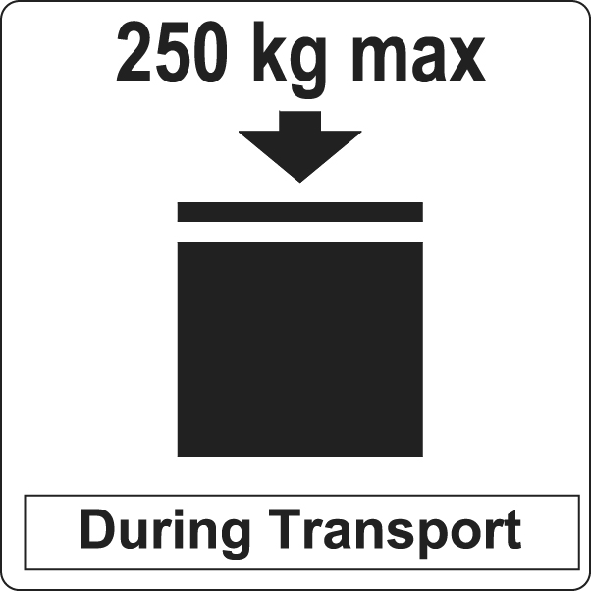
Ibc compliance workshop: 2020
Stacking Mark
Must be placed on all repaired, remanufactured or new IBCs
RIPA recommends applying to IBCs that are routinely maintained
Lower maximum weight (kg) than new

Slide 38
Ibc compliance workshop: 2020
What if the original mark is partially gone or gone or no longer legible?
DOT requires reprocessors to re-apply the original full mark on the IBC.
Damaged markings, or markings difficult to read must be restored and returned to their original condition.
Note: Many reprocessors create a chart of common markings found on incoming IBCs. If a mark is missing or damaged, employees can refer to the chart.

Slide 39
Ibc compliance workshop: 2020
IBC TESTING, RETESTING & RECORDKEEPING

Slide 40
Ibc compliance workshop: 2020
“Leak tightness” testing for
Routine maintenance
There is no DOT approved method for conducting test!
  Two common options using air pressure -
    Solution over discharge valve for “sufficient” time
    Water submersion of discharge valve for “sufficient” time
    Note: Other non-air pressure methods are acceptable
“Leakproofness” testing
New, repaired and remanufactured IBCs
    Inner receptacle tested without cage
    20 kPa (or 2.9 psi) air pressure for “suitable time”
    Soap solution on seams and joints (or other effective method)
    Pass criteria: No leakage of air from IBC

Slide 41
Ibc compliance workshop: 2020
IBC Retest & Inspection (2.5- and 5-year)
2.5-years from original manufacture date on the bottle or last repair.
Reprocessor must perform:
Remove bottle from cage for inspection
Inspect bottle and cage to ensure the IBC is -
Properly marked
Service equipment is functional
IBC is “capable” of passing performance tests

Slide 42
Ibc compliance workshop: 2020
IBC Retest & Inspection (5-year)
5-years from the original manufacturer’s date or date of last repair. Reprocessor must perform:
Leakproofness test
External and internal inspections, with bottle outside the cage to ensure:
No cracking or warping that would be unsafe
Proper marking
Service equipment is functional
IBC is “capable” of passing performance tests

Slide 43
Ibc compliance workshop: 2020
REcordkeeping
Remanufactured IBCs (“cross-bottled”)
Maintain a CURRENT copy of the design type test
Hold copies of report for 2.5 years after last sale of any design type.
General retest and inspection records
Description of design types/packaging spec’s (e.g. “composite”)
Test and inspection dates
Name and address of facility
Name of person conducting tests/inspections
Results of tests/inspections
Keep test records for 2.5 years AFTER production and inspection

Slide 44

Ibc compliance workshop: 2020
QUESTIONS?

Slide 45
IBC compliance workshop: 2020
Q & A
Does the DOT regulate the size of the characters that appear in a UN mark on an IBC?
Yes. Believe it or not, DOT says that size matters. Every character in an IBC mark must be clearly visible and at least 12 mm (1/2”) in height.
(See §178.703)

Slide 46
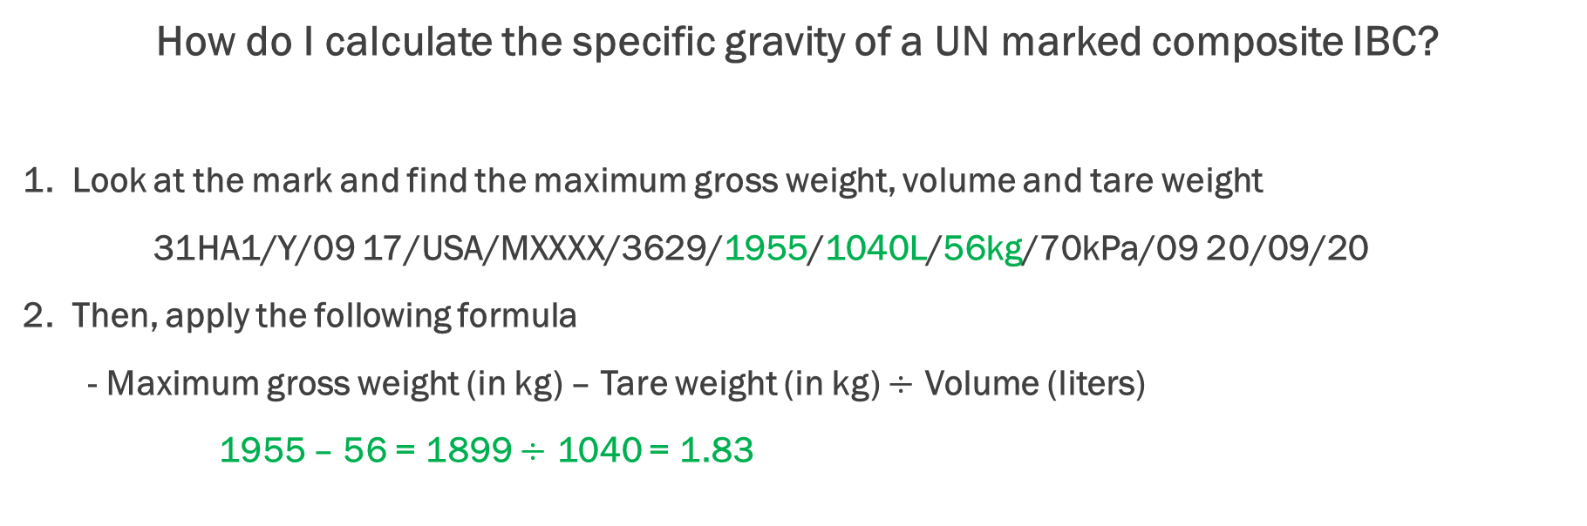
IBC Compliance workship: 2020
Q & A
How do I calculate the specific gravity of a UN marked composite IBC?
1. Look at the mark and find the maximum gross weight, volume and tare weight
31HA1/Y/09 17/USA/MXXXX/3629/1955/1040L/56kg/70kPa/09 20/09/20
2. Then, apply the following formula
- Maximum gross weight (in kg) – Tare weight (in kg) $÷$ Volume (liters)
1955 – 56 = 1899 $÷$ 1040 = 1.83

Slide 47
IBC compliance workshop: 2020
Q & A
Must “stack load” labels be placed on all IBCs?
No. Stack load labels only need to be applied to IBCs that will be used to transport UN-regulated materials (i.e. UN-marked IBCs).
(See §178.703(b)(7))

Slide 48
Ibc compliance workshop: 2020
Q & A
Can you reprocess a composite IBC that was produced outside of the United States?
Yes, DOT allows companies to reprocess UN-marked IBCs made outside of the U.S. It is critical that the company give its customers appropriate closure instructions. If the closure instructions are written by the reprocessor, keep a note on file which describes how you selected the appropriate closure torque range.

Slide 49
Ibc compliance workshop: 2020
Q & A
How often must IBC reprocessors supply their customers with closure instructions?
RIPA recommends that reprocessors give customers closure instructions at least once per year for each design type. Email may be used. Copies of the instructions must be kept for a year after they have been given to a customer.
(See §178.2)

