Slide 1

HAZCOM 2012
Worker Training

Slide 2
Occupational Safety and Health Administration – OSHA
“HAZCOM 2012”: new OSHA rules to conform with the…
Globally Harmonized System – GHS
Worker Training Due December 1, 2013

Slide 3
This is “one-time” training. No periodic, refresher training is required.
No test or training certificate is required. However, a “Certificate of Training” is provided here (last slide). Should be placed in employees’ files.
Make as many copies as needed for the number of trainees.

Slide 4
Training: Two Major Parts
I. Hazard Labels on Chemical Containers
II. Safety Data Sheets (SDSs) formerly “Material Safety Data Sheets”

Slide 5
Chemical manufacturers and importers are required to evaluate the hazards of the chemicals they produce or import, and prepare Labels and Safety Data Sheets to convey the hazard information to their downstream customers.
All employers with hazardous chemicals in their workplaces must have Labels and Safety Data Sheets for their exposed workers, and train them to handle the chemicals appropriately.

Slide 6
June 1, 2015 (or Before)
Labels: New GHS Standard Format and
GHS Pictograms on Labels
I. Labels

Slide 7
Hazard Labels Appear on Containers Encountered in the Workplace

Slide 8
A “GHS label” must Include:
Product Identifier e.g., Chemical Name
Signal Word “Danger” or “Warning”
Pictograms see following slides
Hazard Statement e.g., “Causes irritation….”
Precautionary Statement “Keep away from….”
“In case of exposure…”
Supplier’s Name, Address, Phone#

Slide 9
The Following Slides Include:
The Pictogram's Name
&
The Chemical’s Hazard Classifications

Slide 10

Flame
• Flammables
• Pyrophorics
• Self-Heating
• Emits Flammable Gas
• Self-Reactives
• Organic Peroxide

Slide 11

Flame Over Circle
• Oxidizers

Slide 12

Exploding Bomb
• Explosives
• Self-Reactives
• Organic Peroxide

Slide 13

Skull and Crossbones
• Acute Toxicity
(fatal or toxic)

Slide 14

Corrosion
• Skin Corrosion / Burns
• Eye Damage
• Corrosive to Metal

Slide 15

Gas Cylinder
• Gases Under Pressure

Slide 16

Health Hazard
• Carcinogen
• Mutagenicity
• Reproductive Toxicity
• Respiratory Sensitizer
• Target Organ Toxicity
• Aspiration Toxicity

Slide 17

Exclamation Mark
• Irritant (skin and eye)
• Skin Sensitizer
• Acute Toxicity (harmful)
• Narcotic Effects
• Respiratory Tract
Irritant
• Hazardous to Ozone
Layer (Non-Mandatory)

Slide 18

Environment
(It is optional to apply this label)
• Aquatic Toxicity

Slide 19
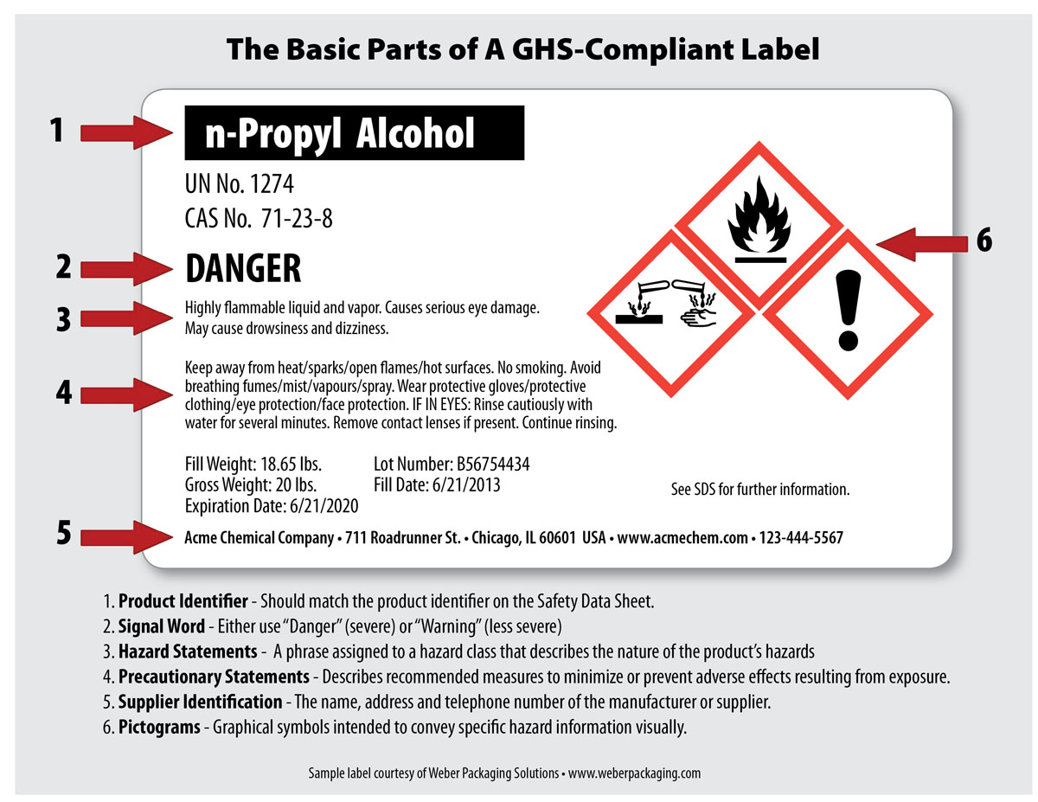

Slide 20
II. Safety Data Sheets
Formerly called Material Safety Data Sheets (MSDS)
To be accessed by workers in the event of a chemical exposure or chemical release emergency.

Slide 21
June 1, 2015 (or before)
A new, uniform 16-section format
All SDS’s must follow this format

Slide 22
SDS Sections
1. Identification
2. Hazard(s) identification
3. Composition/information on ingredients
4. First-aid measures
5. Fire-fighting measures
6. Accidental release measures
7. Handling and storage
8. Exposure controls/personal protection
9. Physical and chemical properties
10. Stability and reactivity
11. Toxicological information
12. Ecological information (non-mandatory)
13. Disposal considerations (non-mandatory)
14. Transport information (non-mandatory)
15. Regulatory information (non-mandatory)
16. Other information

Slide 23
It is important that employees understand that information on a label does relate to information on the SDS.
For instance, the Signal Word (“Danger” or “Warning”), as well as the Hazard Statement on a label are found in Section 2 of an SDS: Hazard Identification.

Slide 24
Chemical companies and importers will have to re-format their SDS’s. Many have already begun this work.
Employees must have unencumbered access to SDS’s, without leaving their work area.

Slide 25
RIPA Offers an SDS Yearly Subscription
(Through a 3rd-Party Provider)
24-Hour, 7-Days SDS Fax-on-Demand
Affordable, Convenient Service
OSHA-Compliant, GHS-Compliant
Member Signup is Each December for Upcoming Calendar Year

Slide 26
Special Note 1: Combustible Dusts
Implications for Steel Shot
Combustible dust hazards must be addressed on GHS Labels and SDS’s.
Label elements are provided for combustible dust and include the signal word “Warning” and the hazard statement "May form combustible dust concentrations in the air".

Slide 27
Special Note 2: Written HazCom Plans
OSHA regulations have required for many years a written Hazard Communication Plan.
RIPA has provided members a template; an easy-to-use format to “fill in the blanks”.
That template will be updated to reflect the new GHS label and SDS rules.
Updating is due June 1, 2016

Slide 28

Certificate of Training
OSHA “HAZCOM 2012”
Globally Harmonized System (GHS)
Worker / Employee Training
Chemical Labels and Safety Data Sheets (SDS)
Trainee’s Name: _________________ Training Date: ____________
Employer: __________________________________________
Training Location (address) _______________________________________________
_______________________________________________

